Slide 1

SUPPER PROGRAM FOR FOOD SERVICES MANAGERS
Notes:
PLACEHOLDER

Slide 2
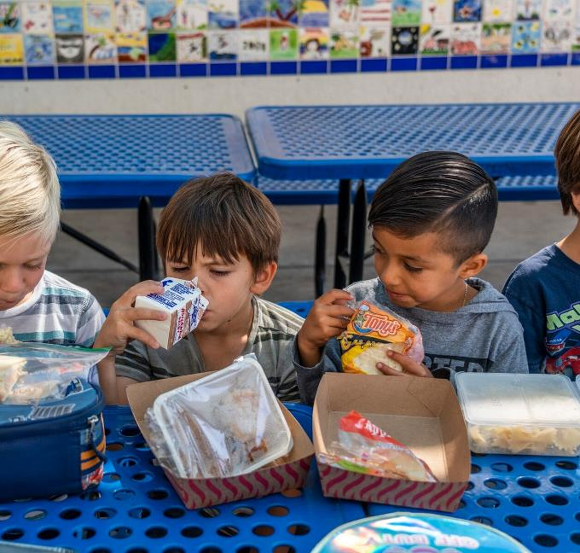
Objective
The goal of the Food Services Division is to provide access to nutritious supper meals to as many students and community participants of eligible schools with afterschool programs.
Notes:
TELL: The goal of the Food Services Division is to provide access to nutritious hot supper meals to as many students and community participants of eligible schools with afterschool programs.

Slide 3
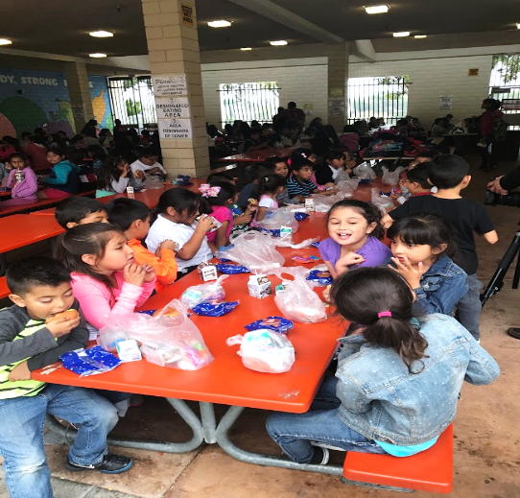
Supper Program Eligibility
There must be an enrichment program on site to offer the Supper Program.
  Schools must be greater than 50% eligible
  Community children under the age of 18 are eligible
  Adults over 18 with disabilities may participate
Notes:
TELL: Participants ages 18 and under are eligible for a free supper meal after school. Participants do not have to be enrolled in an after school program or participate in any offered activities. Disabled individuals of any age may participate.

Slide 4
Annual Training
Food Service Division (FSD) is required to provide annual CACFP supper training to all Food Services Staff (FS), After School Early Childhood Program (AECP) Staff, and After School Program (ASP) Staff before the start of every school year, new program, and to new employees.
Notes:
TELL: FSD is required to provide annual CACFP supper training to all Food Services (FS) and After School Program (ASP) staff before the start of every school year, implementation of a new program, and to new employees.

Slide 5
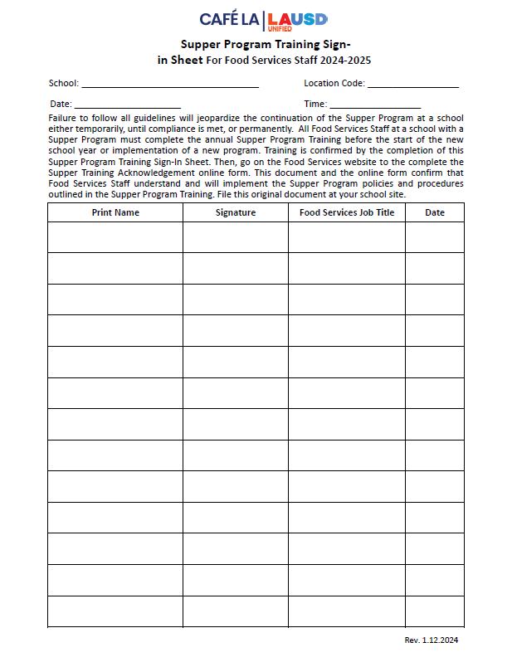
Training Verification Forms
  FS Supper Program Training Sign in sheet
There are two Supper Program Training Sign-In Sheets:
Once FS staff has been trained and the sign-in sheet has been signed an online training acknowledgement form must be completed.
Notes:
TELL: Let’s talk about the Counting and Claiming forms. There are 2 versions of the ASP Supper Grid Sheet and the Community Roster: a 5-day and 1-day. Let’s begin with the ASP Supper Grid Sheet.

Slide 6
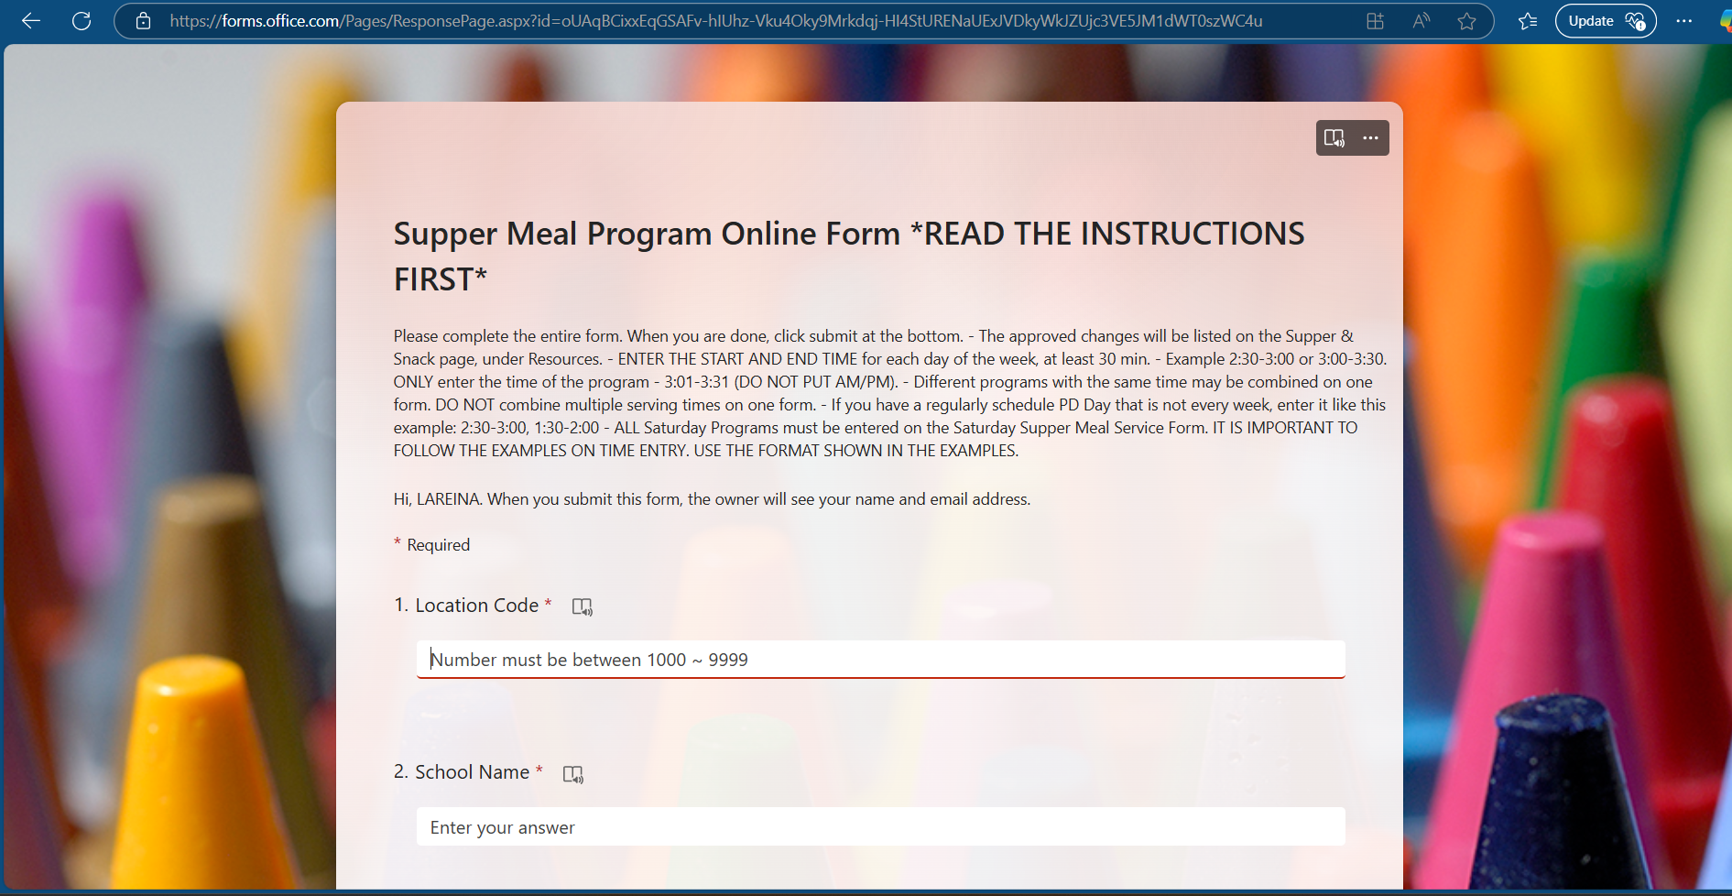
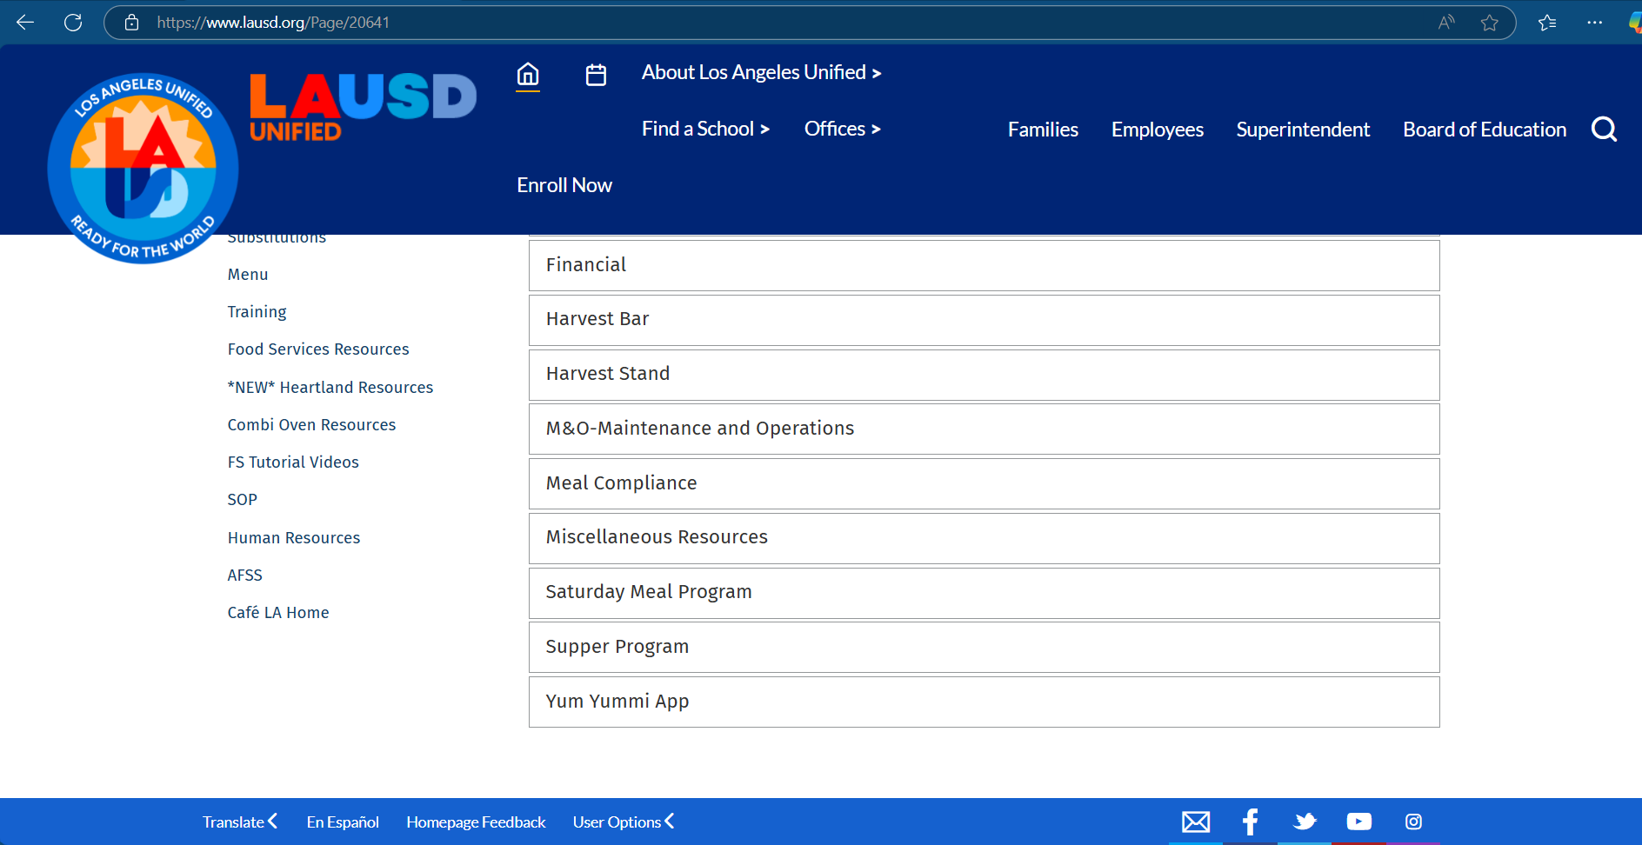
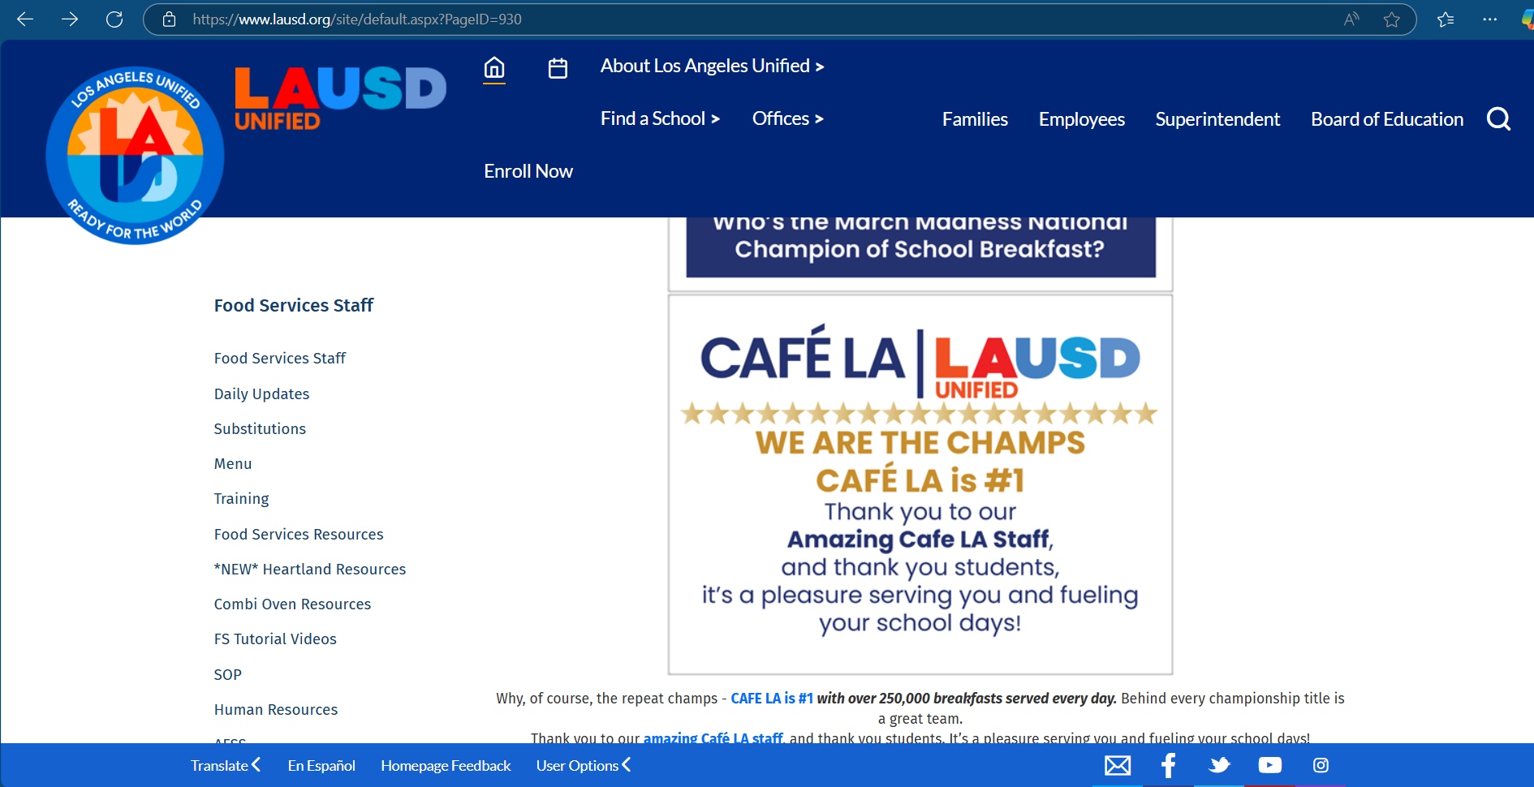
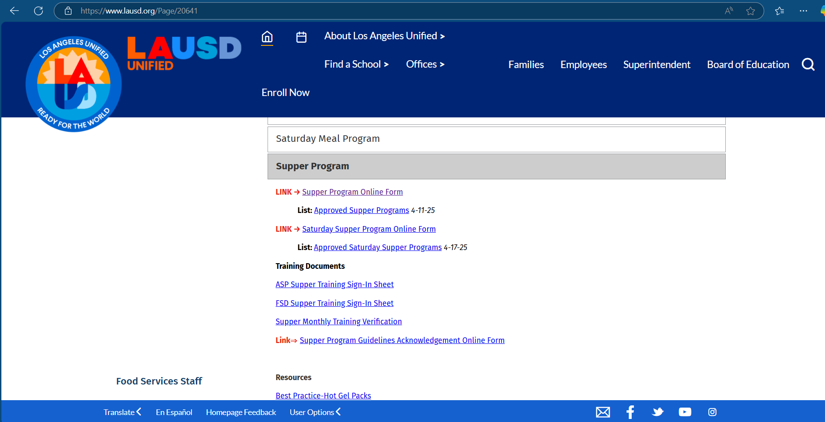

Training Acknowledgement
All trained FS Staff must complete the Supper Training Acknowledgement online form to verify completion of annual training.
  One online form per employee
  Online form is located on the Supper page on the FS website
Note: Due August 22, 2025

Slide 7
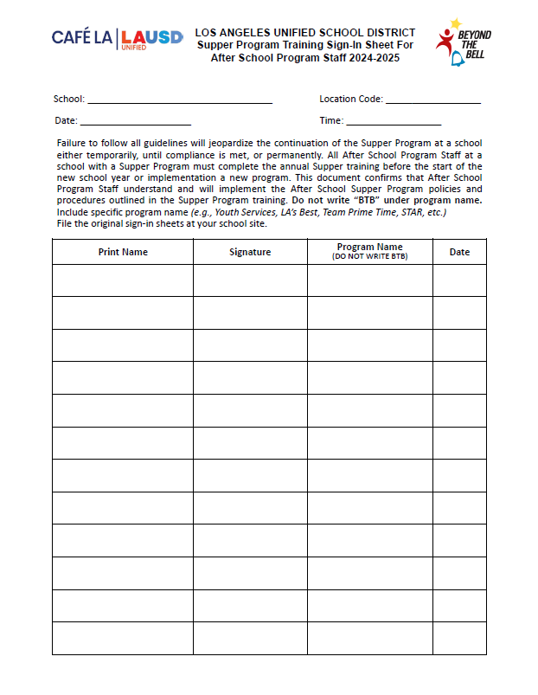
Training Verification Forms
ASP Supper Program Sign-in Sheet
ASP staff must complete the ASP Supper Sign-in Sheet once training is complete.
When completing the ASP Supper Sign-in sheet, program must be specified for each trainee that is signed off.
YDP
LA’s Best
Notes:
TELL: Let’s talk about the Counting and Claiming forms. There are 2 versions of the ASP Supper Grid Sheet and the Community Roster: a 5-day and 1-day. Let’s begin with the ASP Supper Grid Sheet.

Slide 8
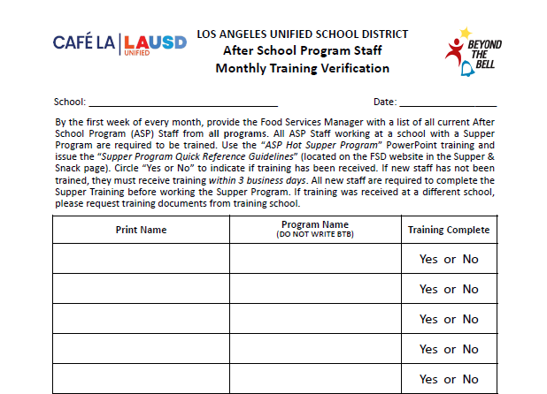
ASP Staff Training
Verification
Due to regular ASP staff turnover, complete the ASP Staff Monthly Training Verification .
  Compare names with ASP Supper Program Training Sign-In Sheet
  Identify staff in need of training
  Provide training for new staff
Happy Elementary
10/18/2025
John Miller
Youth Services
Elizabeth Lee
LA’s Best
George Wilson
LA’s Best
Ann Davis
STAR
Michelle Susette
Boys & Girls Club
Do not write BTB
Note: All staff must be trained prior to working the supper program.
Notes:
TELL: Due to regular ASP staff turnover, complete the ASP Staff Monthly Training Verification. Upon collection, compare names with Supper Program Training Sign-In Sheets. Next, identify any staff in need of training, then provide training for new staff. Please note that all staff must be trained prior to working in the Hot Supper program.

Slide 9
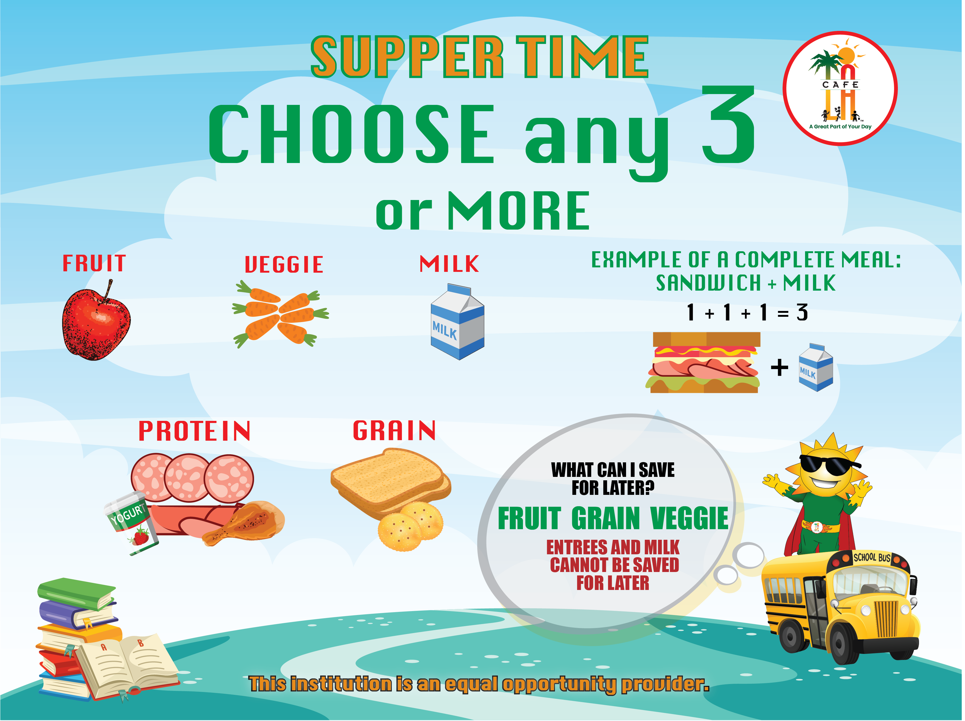
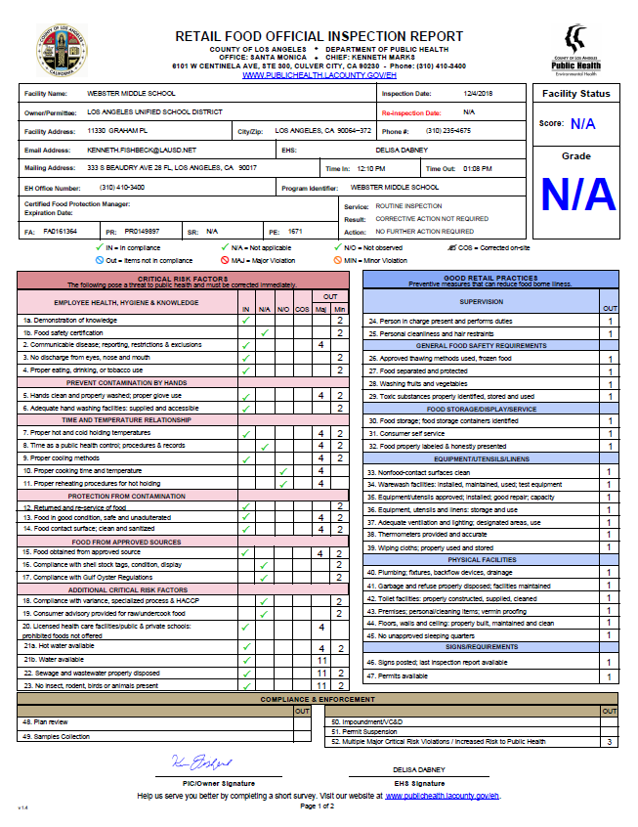
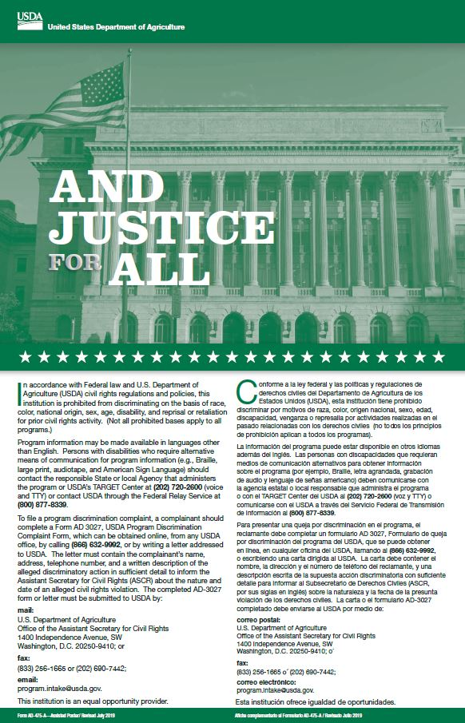
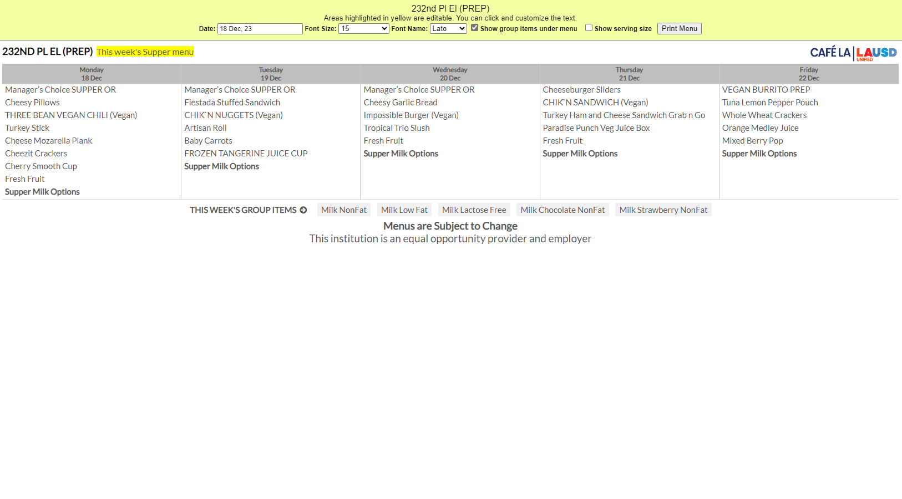
Mandatory Postings
Offer vs Serve Supper Guide
Health Inspection Report
And Justice for All
(11” x17”)
Post all 4 at every service area visible to public view.
Supper Menu
Notes:
TELL: Here are the four required postings for the Hot Supper Program. The Offer vs Serve Supper Guide, the Supper Menu, the Health Inspection Report, and the And Justice for All poster. All three must be posted at every service area visible to public view.

Slide 10
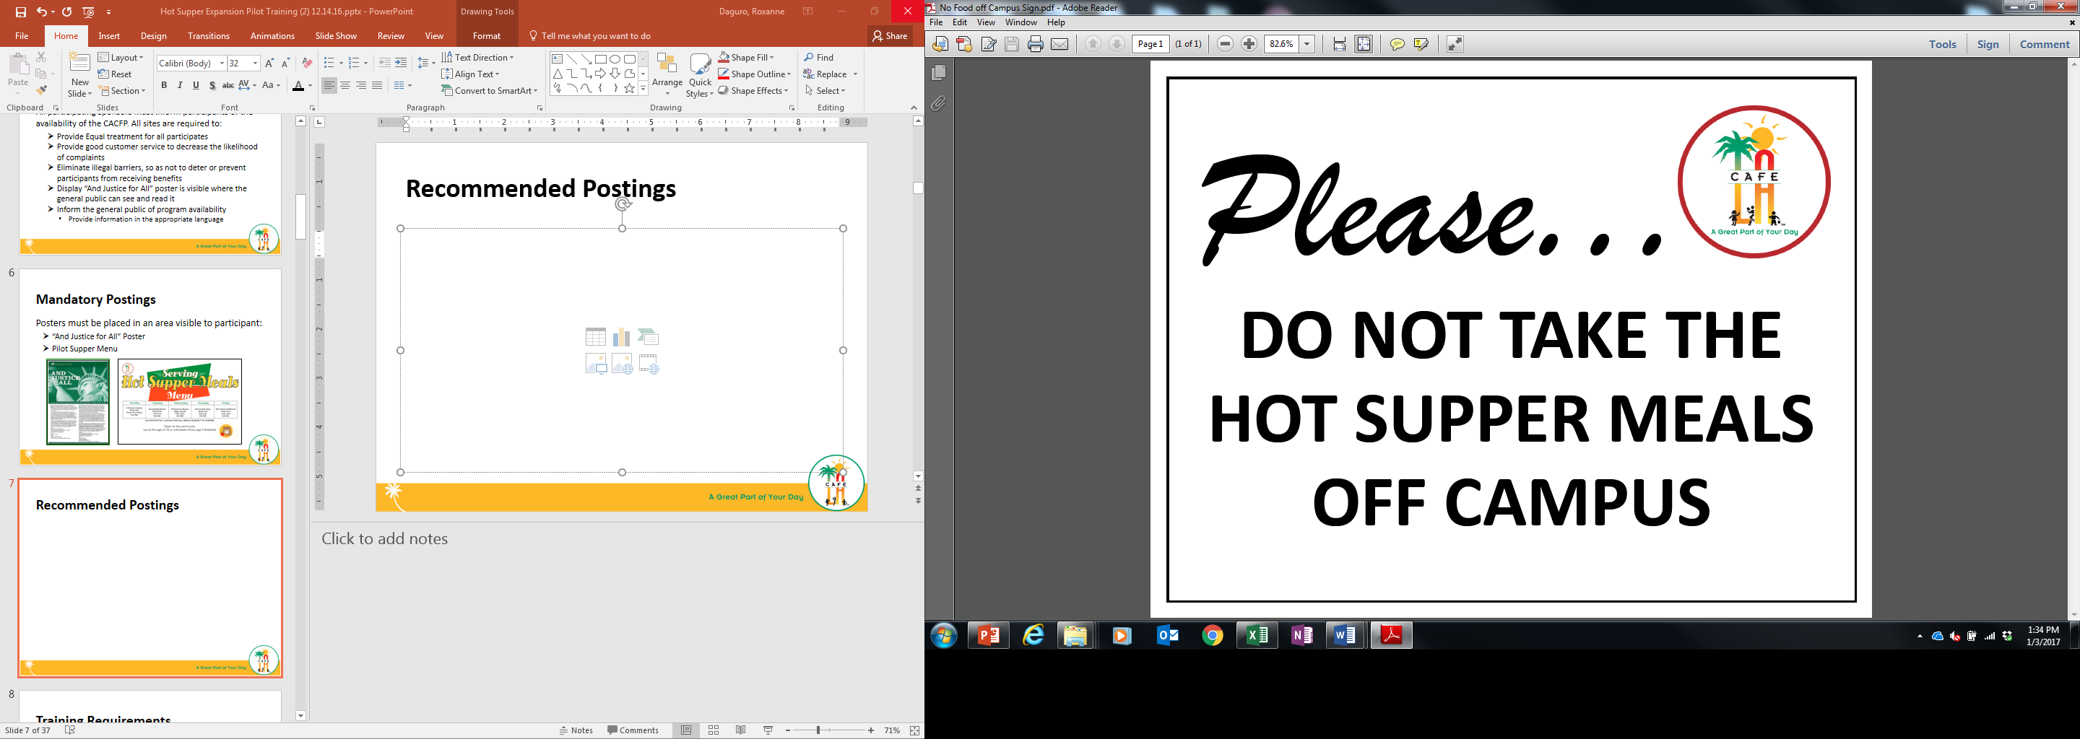

Eating Area Posters
Used to aid students in where to eat supper meals.
Notes:
TELL: Continue to post the Hot Supper marketing material for visual appeal and instruction.

Slide 11
Menu
Guidelines

Slide 12
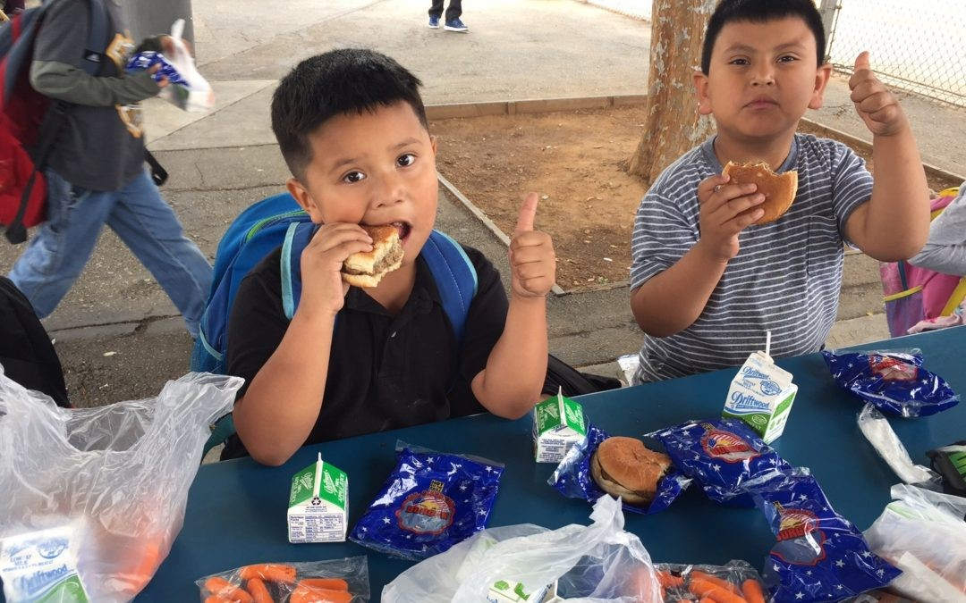
Supper Entrée Selection
When deciding between preparing a hot or cold supper item, select the entrée that will drive the most participation from students at your site.
Serve the more popular item from the menu
Increased participation results in greater revenue
Our service goal is customer satisfaction over convenience

Slide 13
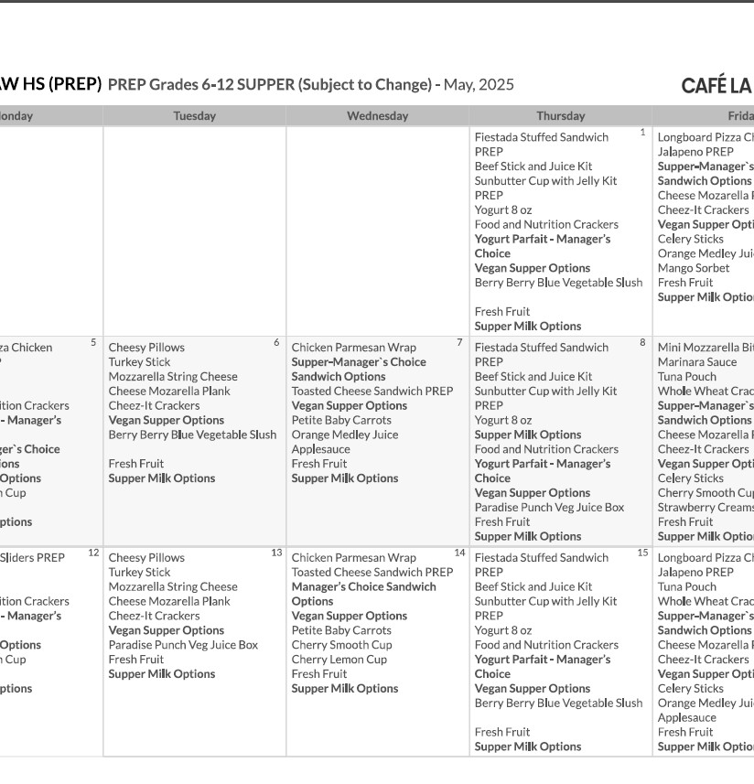
Meal Components
All 5 components must be available to every participant during service; only 3 are required to be selected
Prepare the “4 and Under” menu for AECP and community participants under the age of 4.
Offer 2 different types of milk.

Slide 14
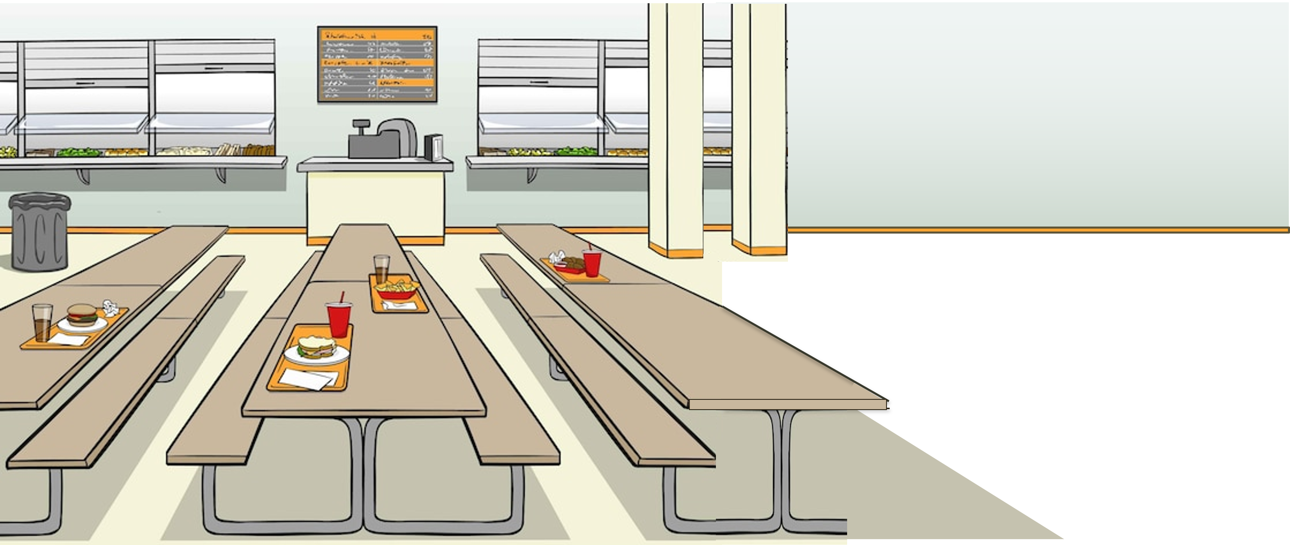



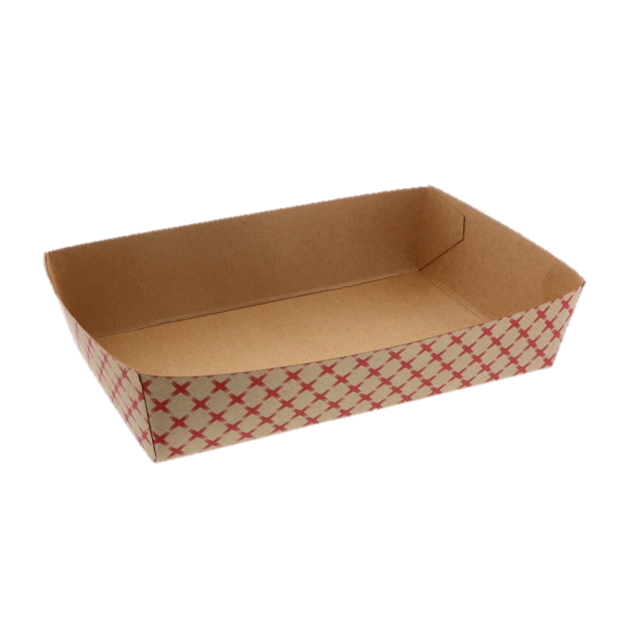


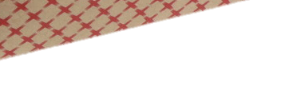

Supper Meal Patterns
All menu items must adhere to a specific portion size and component type to meet reimbursable meal requirements:
Component | Portion size
Fluid Milk | 8 fluid ounces
Meat/Meat alternative | 2-ounce equivalent
Vegetables | ½ cup
Fruits | ¼ cup
Grains | 1-ounce equivalent
Supper meal service must also adhere to OVS guidelines.
  3 of the 5 meal components must be selected to complete a reimbursable meal.
  Student is not required to take a vegetable or fruit during supper.

Slide 15
MEAL PATTERNS & SUBSTITUTIONS
Baby Carrots
  Posted menu must indicate substitutions.
  Cross out former food item and write substitution made in on posted menu.
Notes:
TELL: Substitutions happen, ensure portion size and component type meet reimbursable meal requirements. And remember, the posted menu must indicate substitutions.

Slide 16
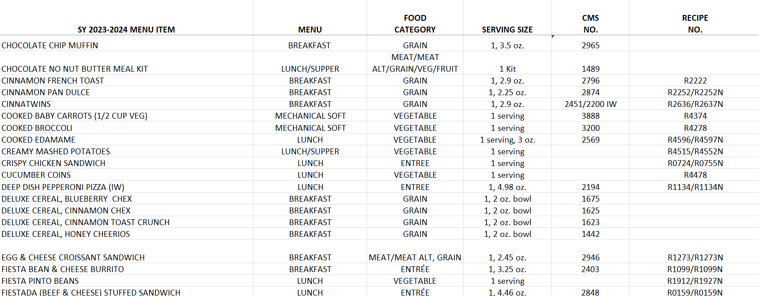
Making Substitutions
When making substitutions, managers refer to the Menu Components Contribution List for an in depth look at the contributions of items offered on the menu. Located on the food services website in Menu’s under Menu Resources.
For substitutions items being used must match in:
Oz equivalency
Grain component
Fruit – Fruit
Vegetable - Vegetable

Slide 17
Unequal Component Substitution
MEAT & GRAIN
MEAT
Breaded Chicken Tenders
Chicken Drumsticks
VS
VEGETABLE
FRUIT
Cherry Smooth Cup
Frozen Strawberry Creamsicle
Notes:
TELL: Let’s identify the components of the following menu items. What components make up the Buffalo Chicken Bites?
CLICK
TELL: That’s right, meat and grain. And the Chicken Drumstick?
CLICK
TELL: Meat. Is that an equal substitution of components? No. Let’s take a look at another example. What component is the Cherry Smooth Cup?
CLICK
TELL: That’s right, it is vegetable. Now what about the Frozen Wild Cherry Cup?
CLICK. It’s a fruit. Is that an equal substitution of components. No, it is not.

Slide 18
Chocolate Milk Rule
The CACFP guidelines restricts the serving of chocolate milk to students under the age of six.
  Offer unflavored milk to children under six
  Children six or older can choose between unflavored or chocolate milk
To ensure compliance, ask children their age if they appear to be less than six years old.
Notes:
TELL: Now let’s talk about chocolate milk. The CACFP guidelines restricts the serving of chocolate milk to students under the age of six. Children under six must be offered unflavored milk. However, children six or older can choose between unflavored or chocolate milk.

Slide 19

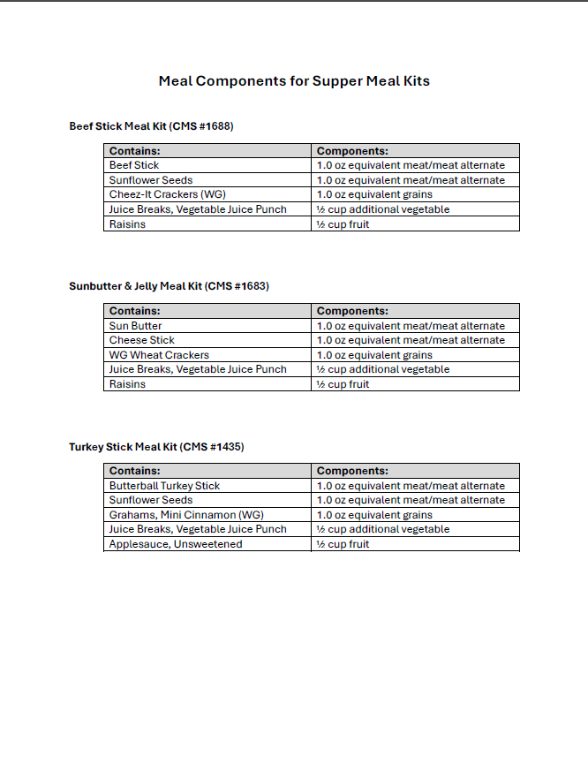
Meal Components for Supper Meal Kits
A menu has been created to detail components of all meal kits served during supper service.
Meal kit will be documented on the Daily Transport Record specifying the meal kits name and CMS number.
  Staple the “Meal Components for Supper Meal Kits “ menu to the Daily Transport Record.
  Write all components of each Meal Kit on the Daily Transport Record.
Food services Website > Menu > Menu Resources
Or

Slide 20
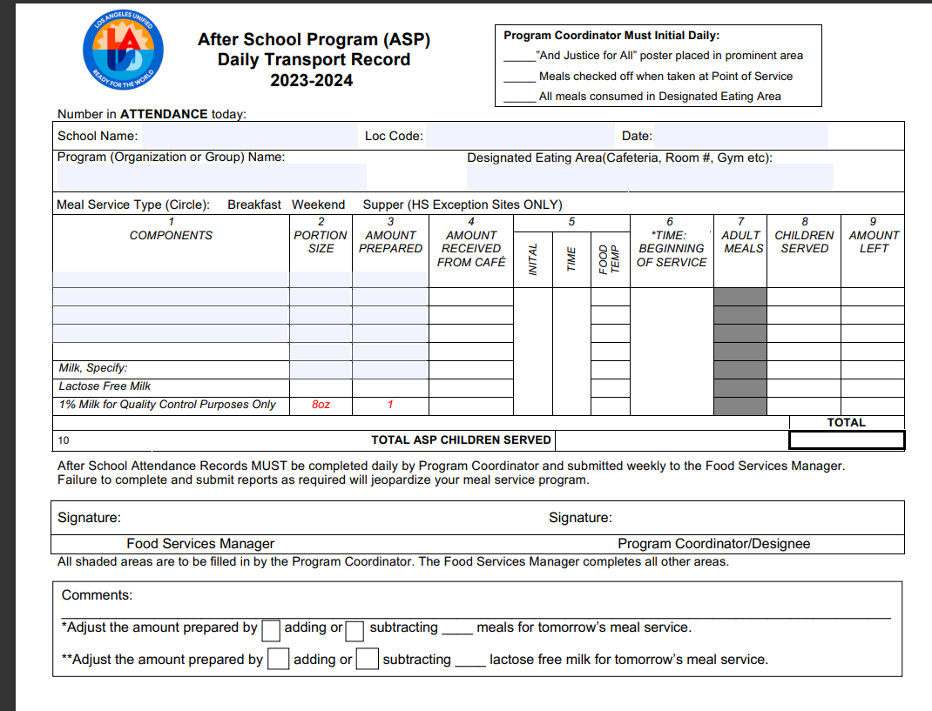
Supper Transport Record
    The Supper Transport Record is used when supper meals are served by ASP staff AND when the cafeteria is closed during supper service.
    Manager or Food Service Staff will:
    Pre-fill the header with school name, location code, date, etc.
    Pre-fill components portion size and amount prepared.
Once received ASP staff will then fill amount received, temp each item and document all counts for meals served.
ASP coordinator must sign at the end of service before returning transport record.
    Manager will sign once record is returned. Signifying all fields have been properly filled.

Slide 21
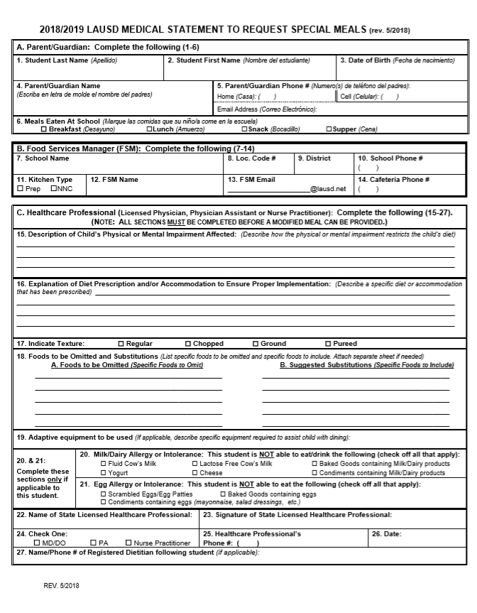
Special Dietary Needs
    Students who require a special meal can complete the “Medical Statement to Request Special Diets” form. Food Services Managers will:
    Provide the form to families for completion by the child’s treating physician
    Submit the completed form to specialdiet@lausd.net
    Make substitutions provided by the Nutrition Specialist
Notes:
TELL: Ensure that temperatures recorded at the Start of Service are within the allowable serving range for safety reasons. Please note that temperatures of cold supper kits and cold food items must also be recorded on the Food Temperature Log.

Slide 22
HOW TO SPOT A REIMBURSABLE MEAL

Slide 23

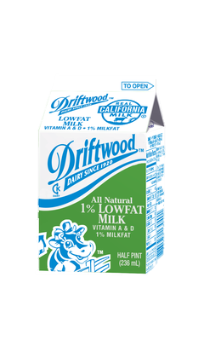
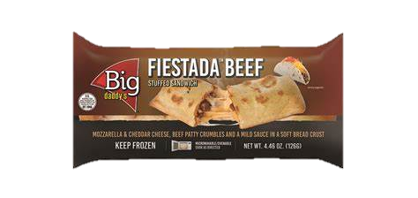




Today’s Menu Items
1 component food items
2 components entrée
Is this a reimbursable meal?

Slide 24
Today’s Menu Items
1 component food items
2 components entrée
Is this a reimbursable meal?

Slide 25

Today’s Menu Items
1 component food items
2 components entrée
Is this a reimbursable meal?

Slide 26

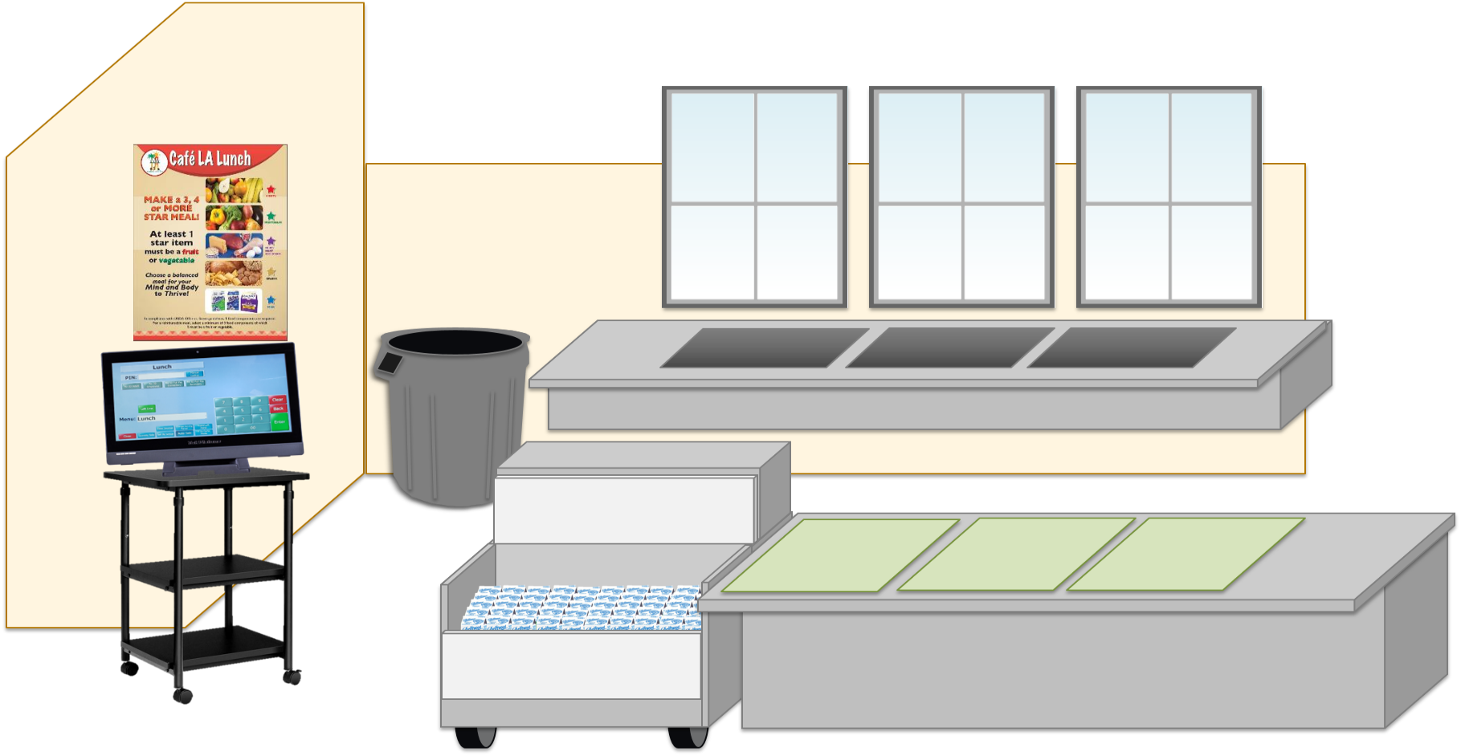

REMINDER
Student is not required to take a vegetable or fruit during supper
3 of the 5 meal components must be selected to complete a reimbursable meal.

Slide 27
Supper Cart Set Up
Because of the OVS model, a supper cart and the BIC dolly may need to be used together to serve supper.
Store food items in BIC insulated bags before service
Use BIC dolly to carry additional bags to supper area on campus
Use the shelf space on cart to store 3lb trays and sporkettes
It is highly recommended to set up near a lunch table in the designated eating
area.

Slide 28
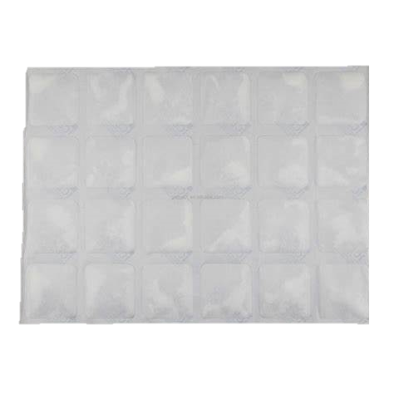


Ice Blankets
When packing supper meals for after school programs use the frozen ice blankets to ensure serving temperatures of cold food items.
Six (6) frozen ice blankets (CMS #4205) per insulated bag
Ice packs should be refrozen daily
Discard damaged (leaking, torn) ice blankets
Refer to the “Ice Blankets Best Practice” located on the Food Services website

Slide 29
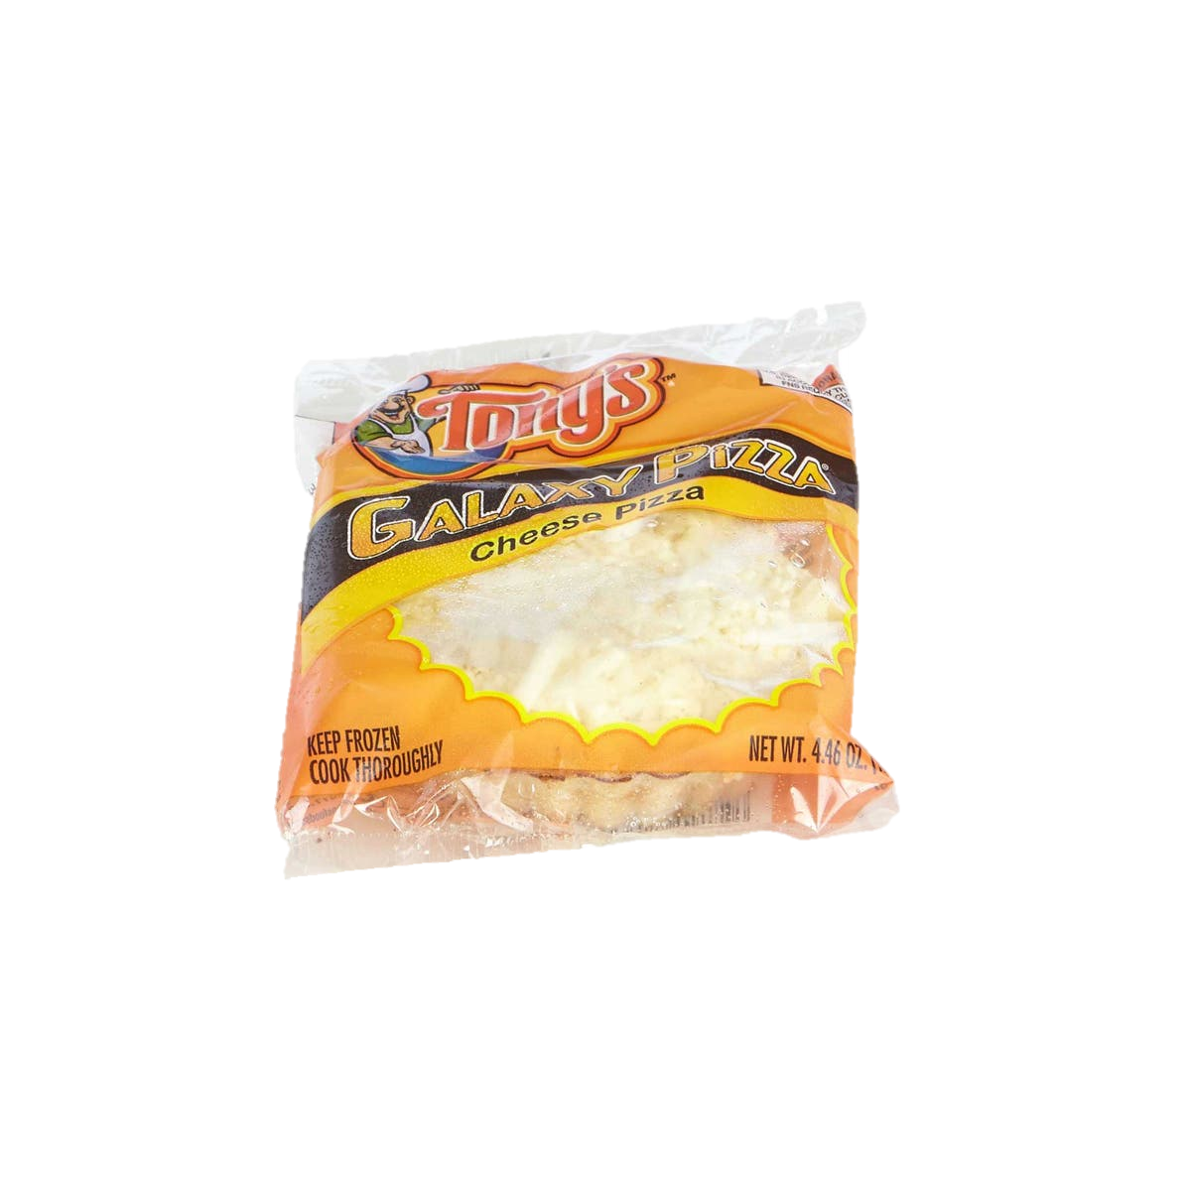
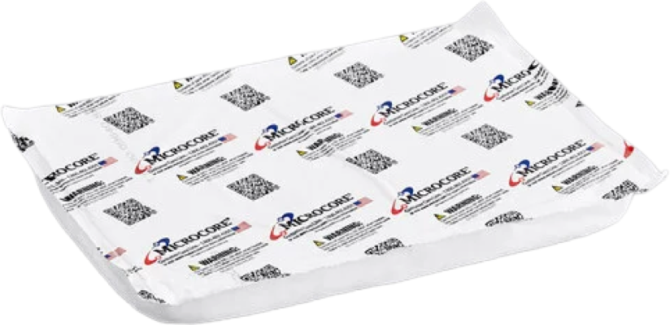
Hot Gel Packs
When packing supper meals for after school programs use the hot gel packs to ensure our serving temperatures of hot food items.
Two (2) hot packs (CMS #4770) per insulated bag
Wear cotton gloves when handling heated hot gel packs
Discard damaged hot gel packs
Refer to the “Hot Gel Packs Best Practice” located on the food services website for additional information

Slide 30
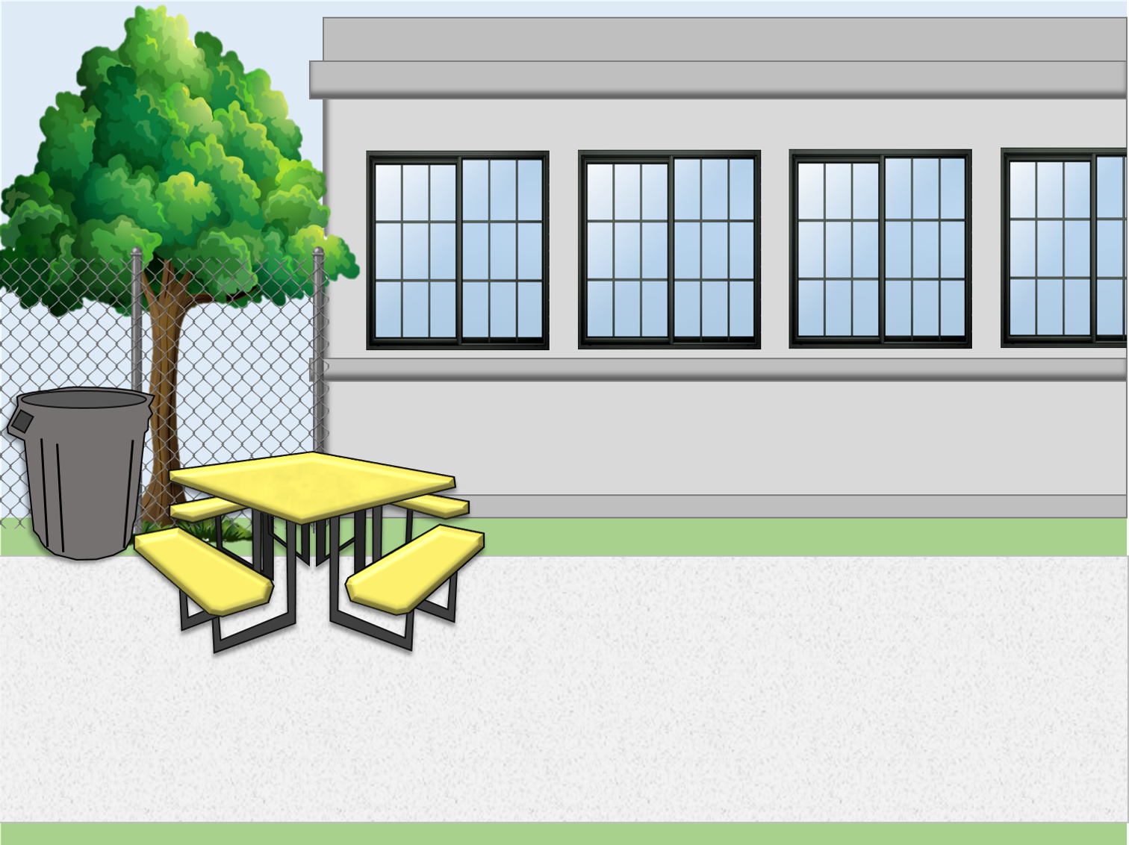

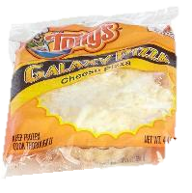

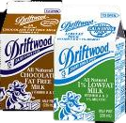




Supper Cart Set Up Example
Your set up may differ according to your participation counts, campus and weekly menu.
Store less popular items in same bag to maximize space
Do not crush or squeeze food items into bags; use an additional bag
This model allows for OVS

Slide 31

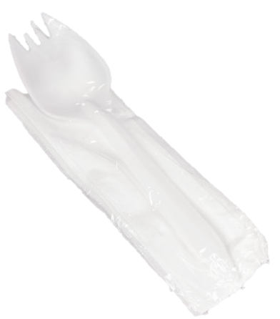
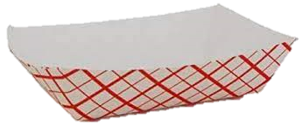

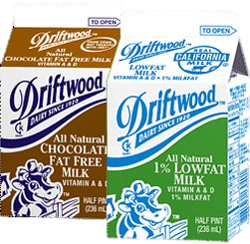

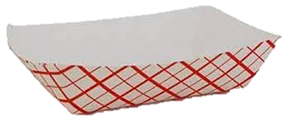
Supper Service Example
Staff must ensure reimbursable meals are served BEFORE recording the meals on the ASP/Community Forms. Meals served that are not reimbursable cannot be claimed.
Notes:
“Staff must ensure reimbursable meals are served BEFORE recording the meals on the ASP/Community Forms. Meals served that are not reimbursable cannot be claimed.”

Slide 32
Community Cart Service
Meal Service lasts for 30 mins immediately after the bell rings, however FSM’s may request approval to shorten or lengthen their meal service through their AFSS.
ASP and FS Staff must ensure reimbursable meals are served BEFORE recording the meals on the ASP/Community Forms. Meals served that are not reimbursable cannot be claimed.
Food Services Staff serves meals to participants from the community
Meals are consumed in the designated eating area. No food may leave the campus.
Redirect program students to the program serving area to receive their meals.
ASP Staff assists with community service for the first ten minutes.
Communicate with ASP to ensure at least one point of service remains open for the entire 30-minute meal service.
    *Exceptions may apply. AFSS approval is required to serve at alternate serving times.

Slide 33
Counting and Claiming

Slide 34
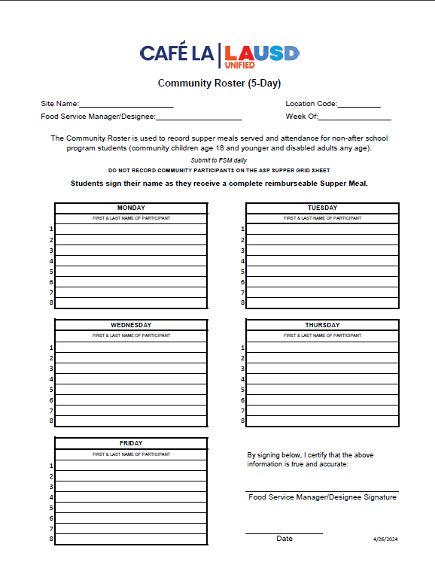
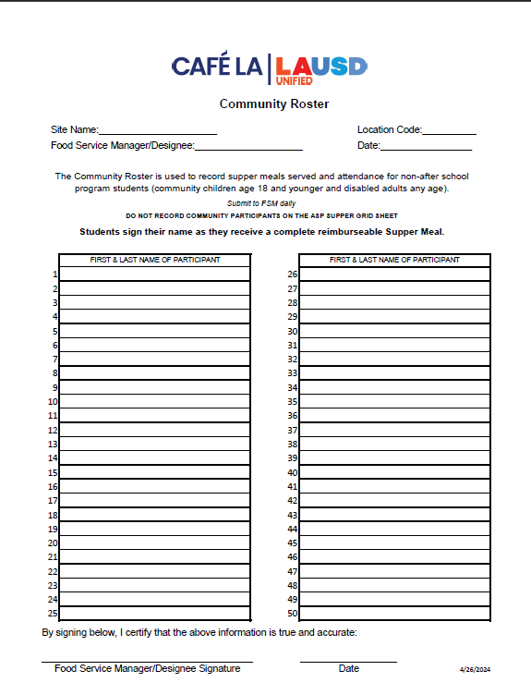
Counting and Claiming Forms
ASP Supper Grid Sheet
Community Roster
5-Day
1-Day
5-Day
1-Day
Notes:
TELL: Let’s talk about the Counting and Claiming forms. There are 2 versions of the ASP Supper Grid Sheet and the Community Roster: a 5-day and 1-day. Let’s begin with the ASP Supper Grid Sheet.

Slide 35
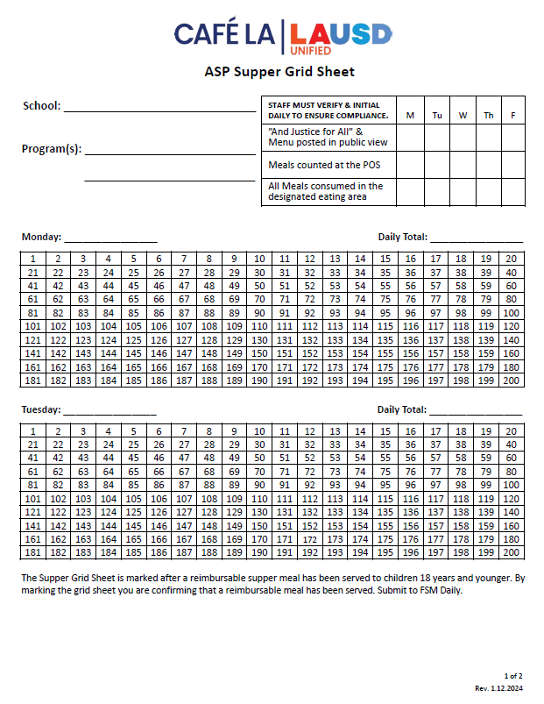
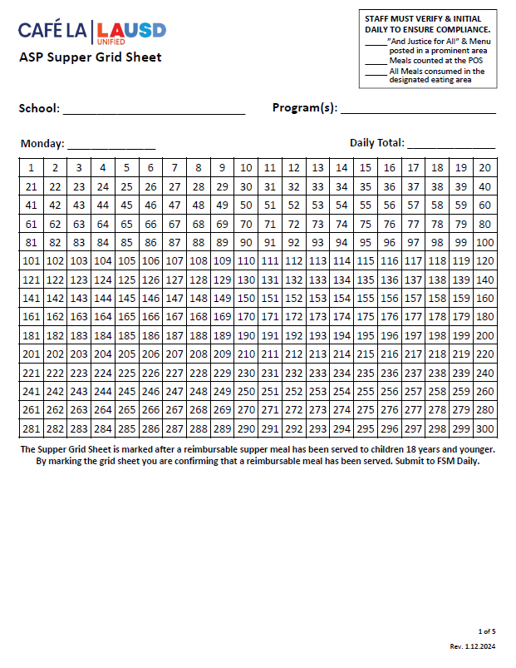
ASP Supper Grid Sheet
These forms record reimbursable meals distributed to the afterschool program students only.
Only trained ASP staff may record meals
Complete heading, date, and record all programs
Verify and initial the compliance box daily
POS staff should focus solely on counting reimbursable meals to ensure accuracy.
Mark each meal in numerical order with a slash or x AFTER a reimbursable meal is served
Record total meal counts daily
Submit to FS Manager daily
5-Day
1-Day
Notes:
TELL: The ASP Supper Grid Sheet records reimbursable meals distributed to the after school program students only. Only trained FS/ASP staff may record the meals distributed. To begin, complete the heading, date, and record all programs. ASP staff must verify and initial the compliance box daily. To claim meals for reimbursement, confirm meal is reimbursable before marking. Then, mark each meal in numerical order with a slash or X. Lastly, record the total meal counts daily. Remember to collect the ASP Supper Grid Sheet daily.

Slide 36
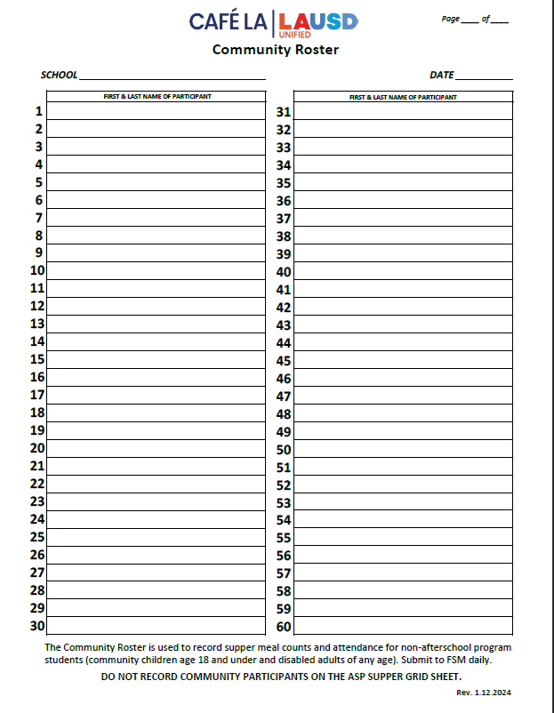
Community Roster
    This form records the attendance and reimbursable meals received by community participants.
      Ensure the first & last names are written legibly
      Young children may be assisted with writing their names
      FS Staff ensures a reimbursable meal is selected before names are recorded
      A community roster is required at all service locations
      To ensure accuracy in meal counting, the POS staff should focus solely on counting reimbursable meals
      Submit to FS Manager daily
1 2
Nicole Waterford
Hannah Bankole
Notes:
TELL: The Community Roster records the attendance and reimbursable meals received by community participants. Ensure first and last names are written legibly. Young children may be assisted with writing their names. This form is required at all service locations. Incomplete names listed may be included in the meal count. However, make every effort to obtain the full name at the next supper service. Remember to collect Community Roster daily.

Slide 37
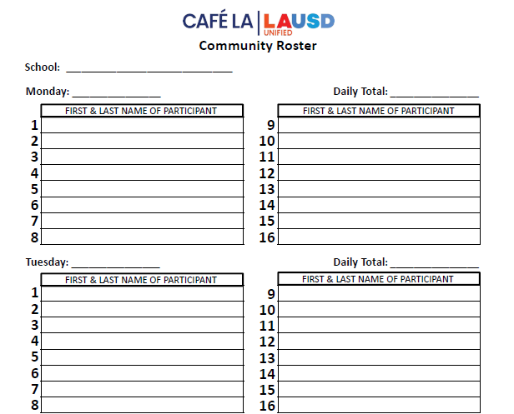

Community Roster Required at ASP Service
Happy El
    ASP staff distributes supper meals to program and community participants.
    However, some ASP Services do not have any community participants.
10/2/2023
0
ZERO PARTICIPANTS
  Is the Community Roster required if
  there are no community participants?
10/3/2023
0
ZERO PARTICIPANTS
Yes!
    ASP staff will confirm that the count is zero and fill the blank form
      Include the school name and date
      Submit to the Food Services Manager daily to be filed
Notes:
TELL: ASP staff distributes supper meals to program and community participants. However, some ASP Services do not have any community participants.
ASK: Is the Community Roster required if there are no community participants?
CLICK
TELL: Yes! Confirm that the count is 0 and file the blank form. Include the school name and date. This blank form must be collected daily.

Slide 38
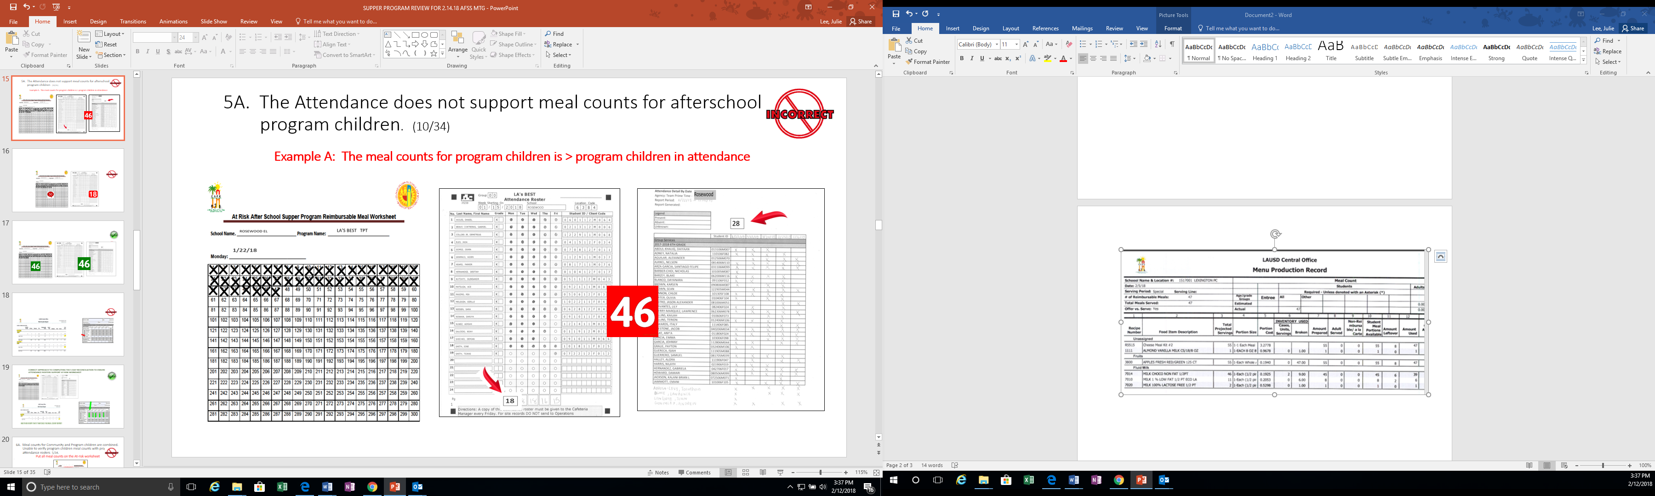
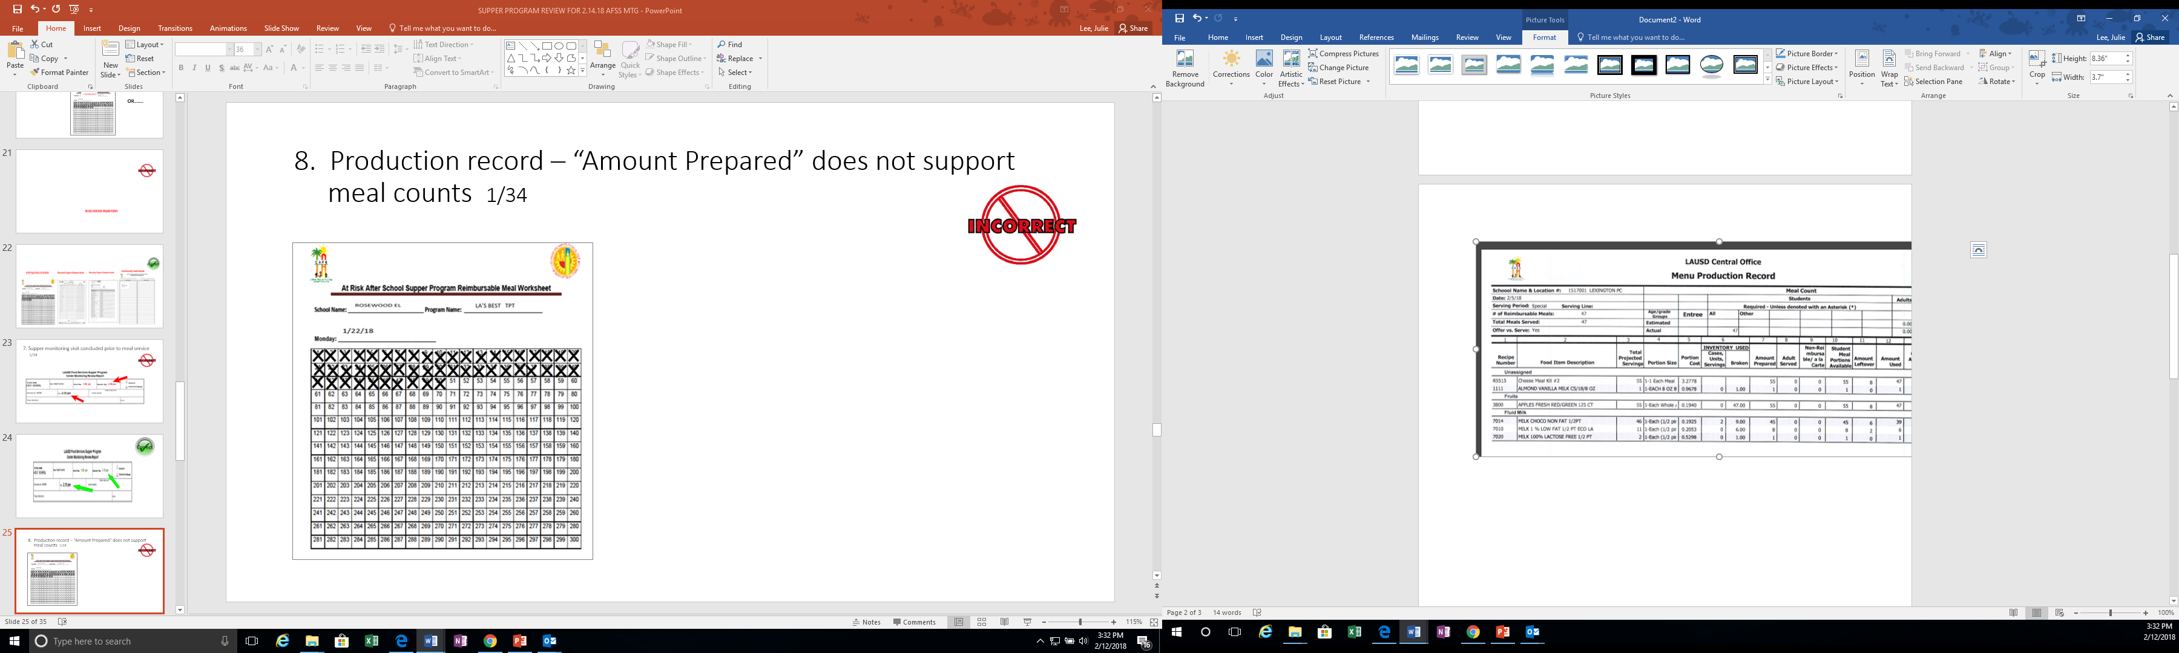
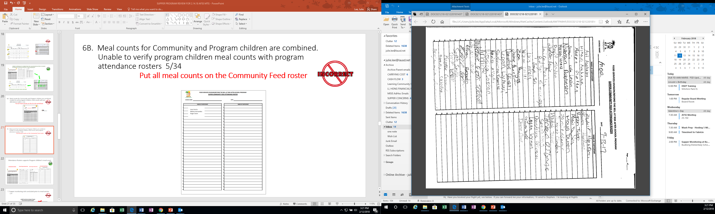
PRODUCTION RECORDS MEAL COUNTS
47
34
81
PRODUCTION RECORDS
(Reimbursable Meals)
ASP Supper Grid Sheet
Community Roster
Reimbursable meal counts on the Production Record must support the ASP Grid Sheet and the Community Roster.
Notes:
TELL: Reimbursable meal counts on the Production Record must support the meal counts on the ASP Grid Sheet and the Community Roster.

Slide 39
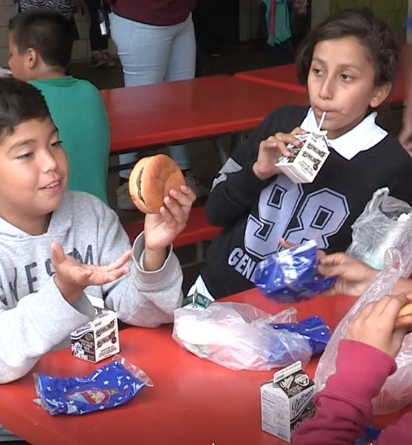
Do Not Back Out Leftovers
“Backing out” is when leftovers are subtracted from the meals prepared to determine the meal count.
  “Backing out” leftovers is strictly prohibited
  Meal counts are obtained from the amounts recorded on the ASP Supper Grid Sheet and the Community Roster
  It is not possible to claim more meals than the amount prepared on the production worksheet
  Meals must be recorded accurately
Notes:
TELL: “Backing out” is when leftovers are subtracted from the meals prepared to determine the meal count.
“Backing out” leftovers is strictly prohibited. Meal counts are obtained from the amounts recorded on the ASP Supper Grid Sheet and the Community Roster. Remember, it is not possible to claim more meals than the amount prepared on the production worksheet. All meals must be recorded accurately.

Slide 40
Claiming for
Reimbursement
Claiming is the request for reimbursement that FSD submits to the California Department of Social Services. FSD obtains this information from the Newton CMS system.
    Meal counts are obtained from ASP Supper Grid Sheet and Community Roster combined
    Manager inputs the total meal count under the MISC counts tab in the Newton CMS system
Notes:
TELL: Claiming is the request for reimbursement that FSD submits to the California Department of Education. FSD obtains this information from CMS. Meal counts are obtained from ASP Supper Grid Sheet and Community Roster combined. Manager inputs the total meal count under “free” in CMS Daily Entry each day

Slide 41

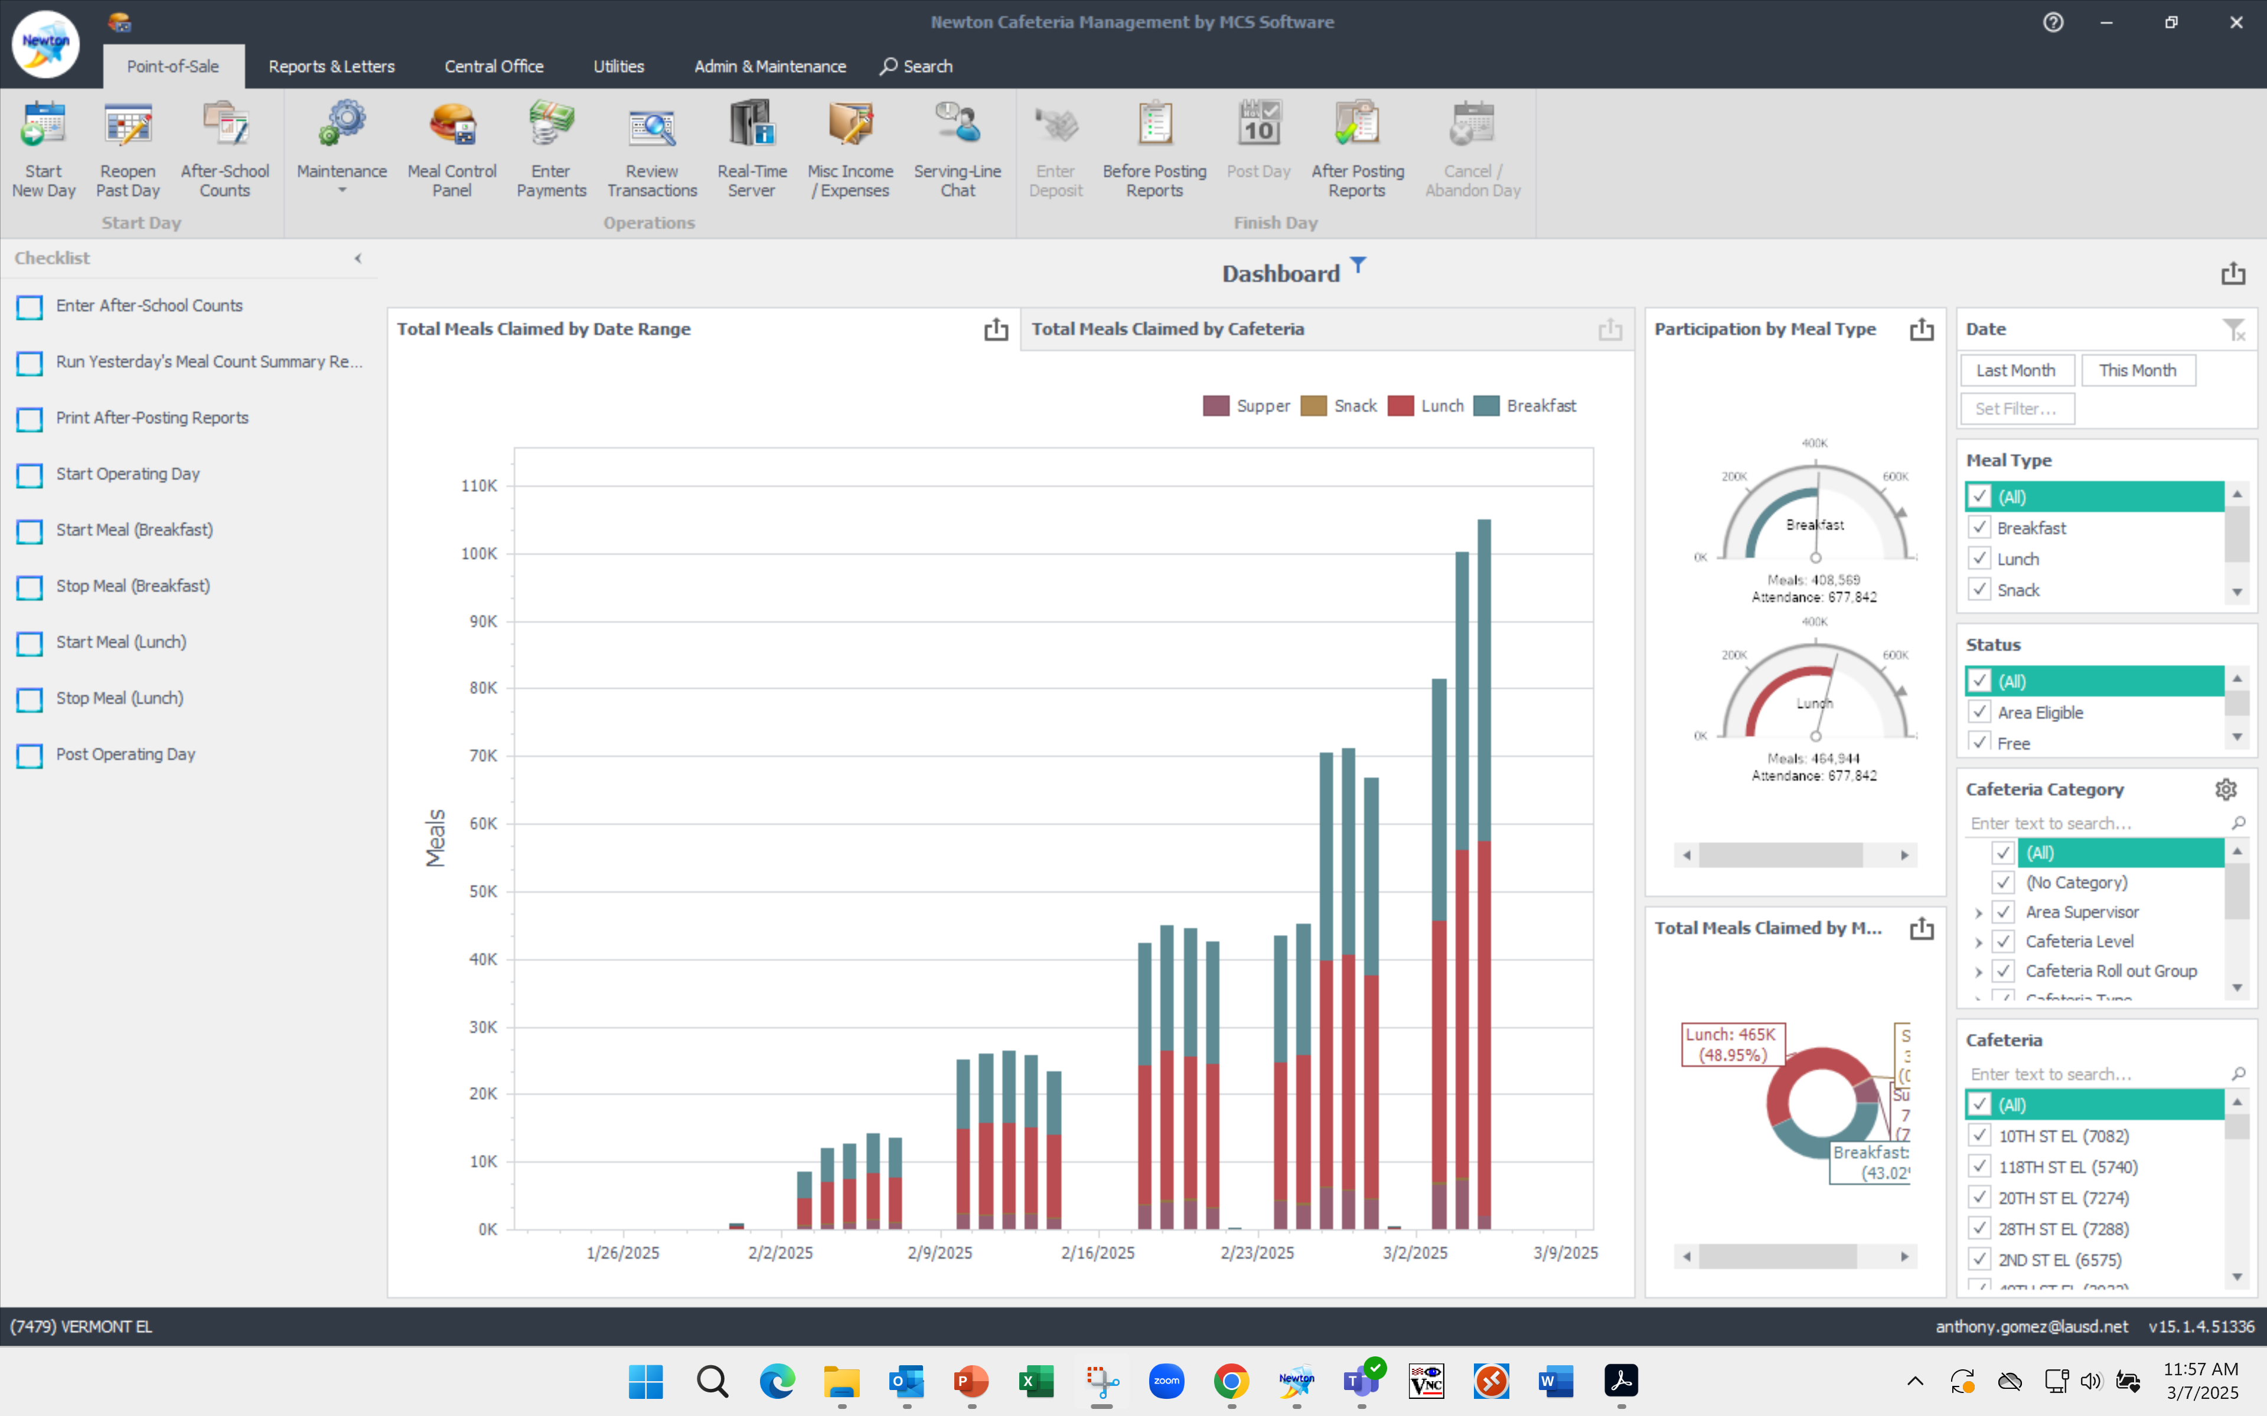
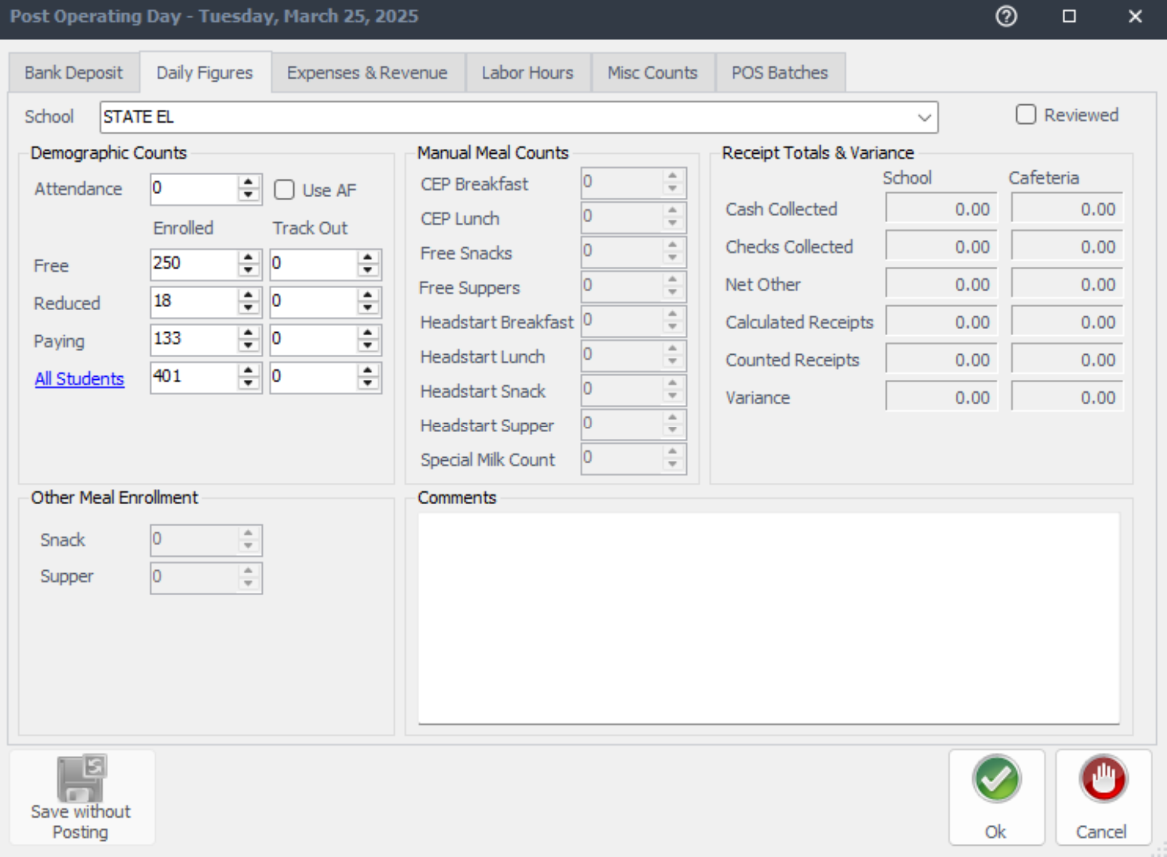
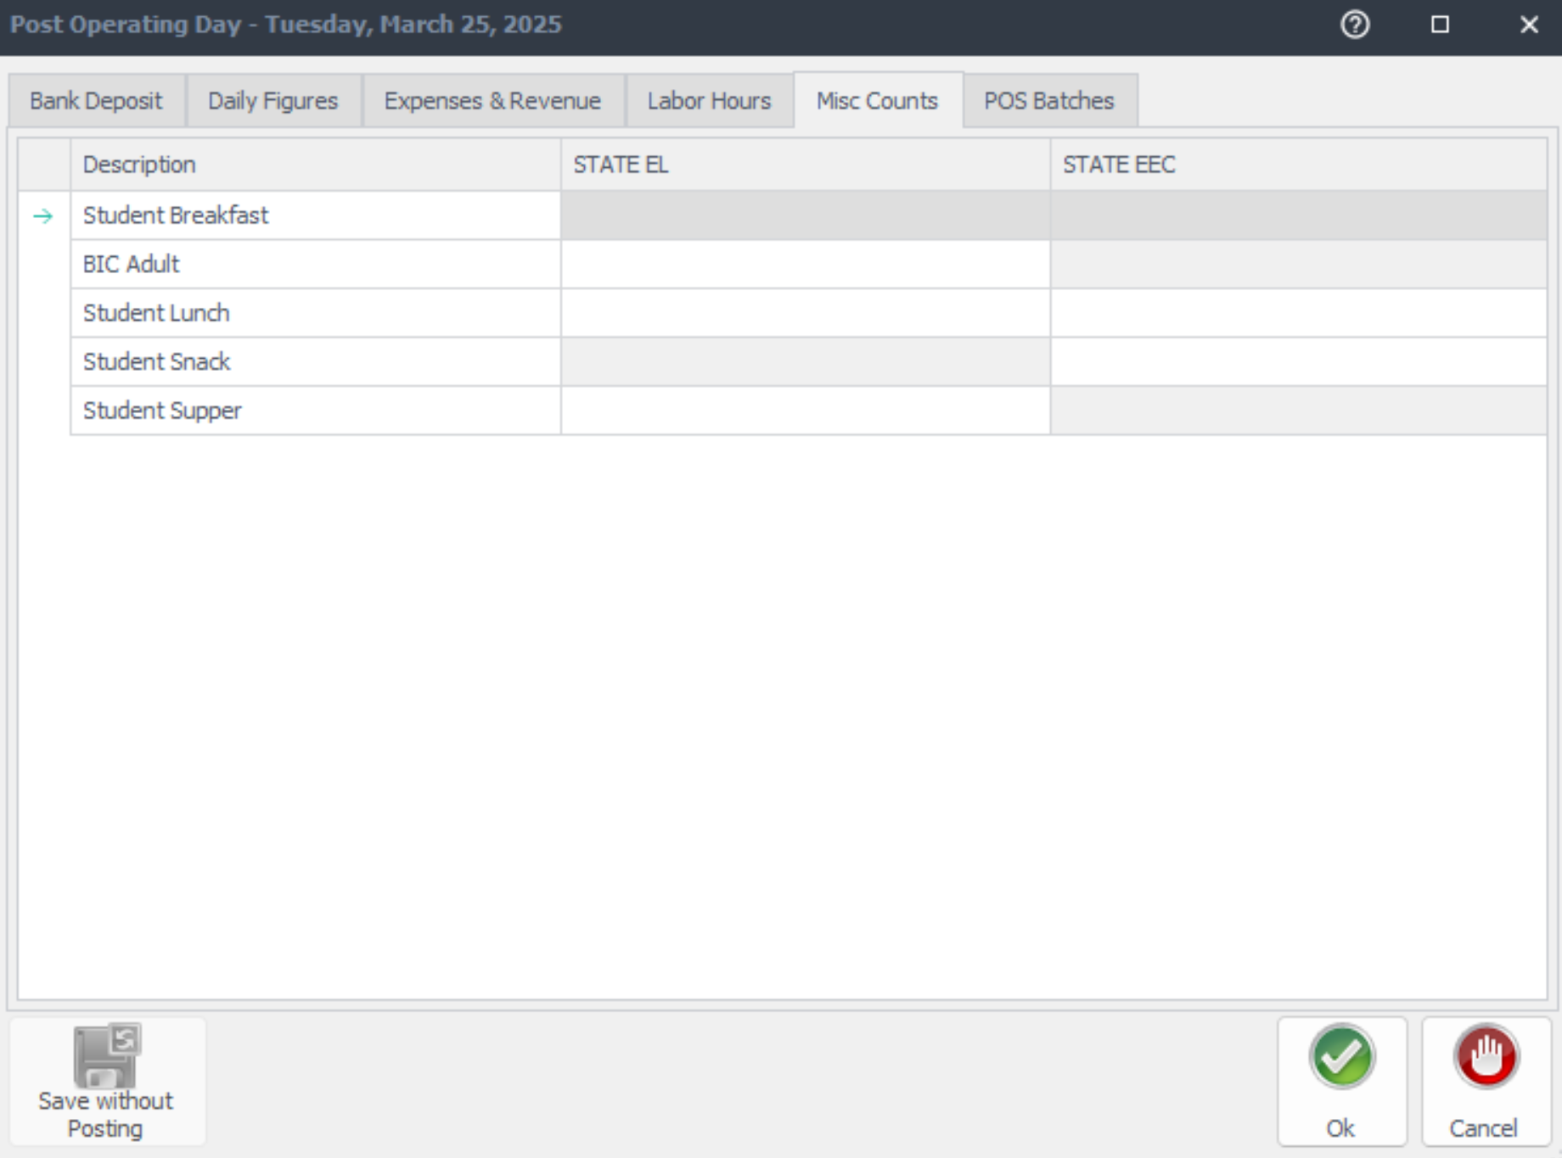
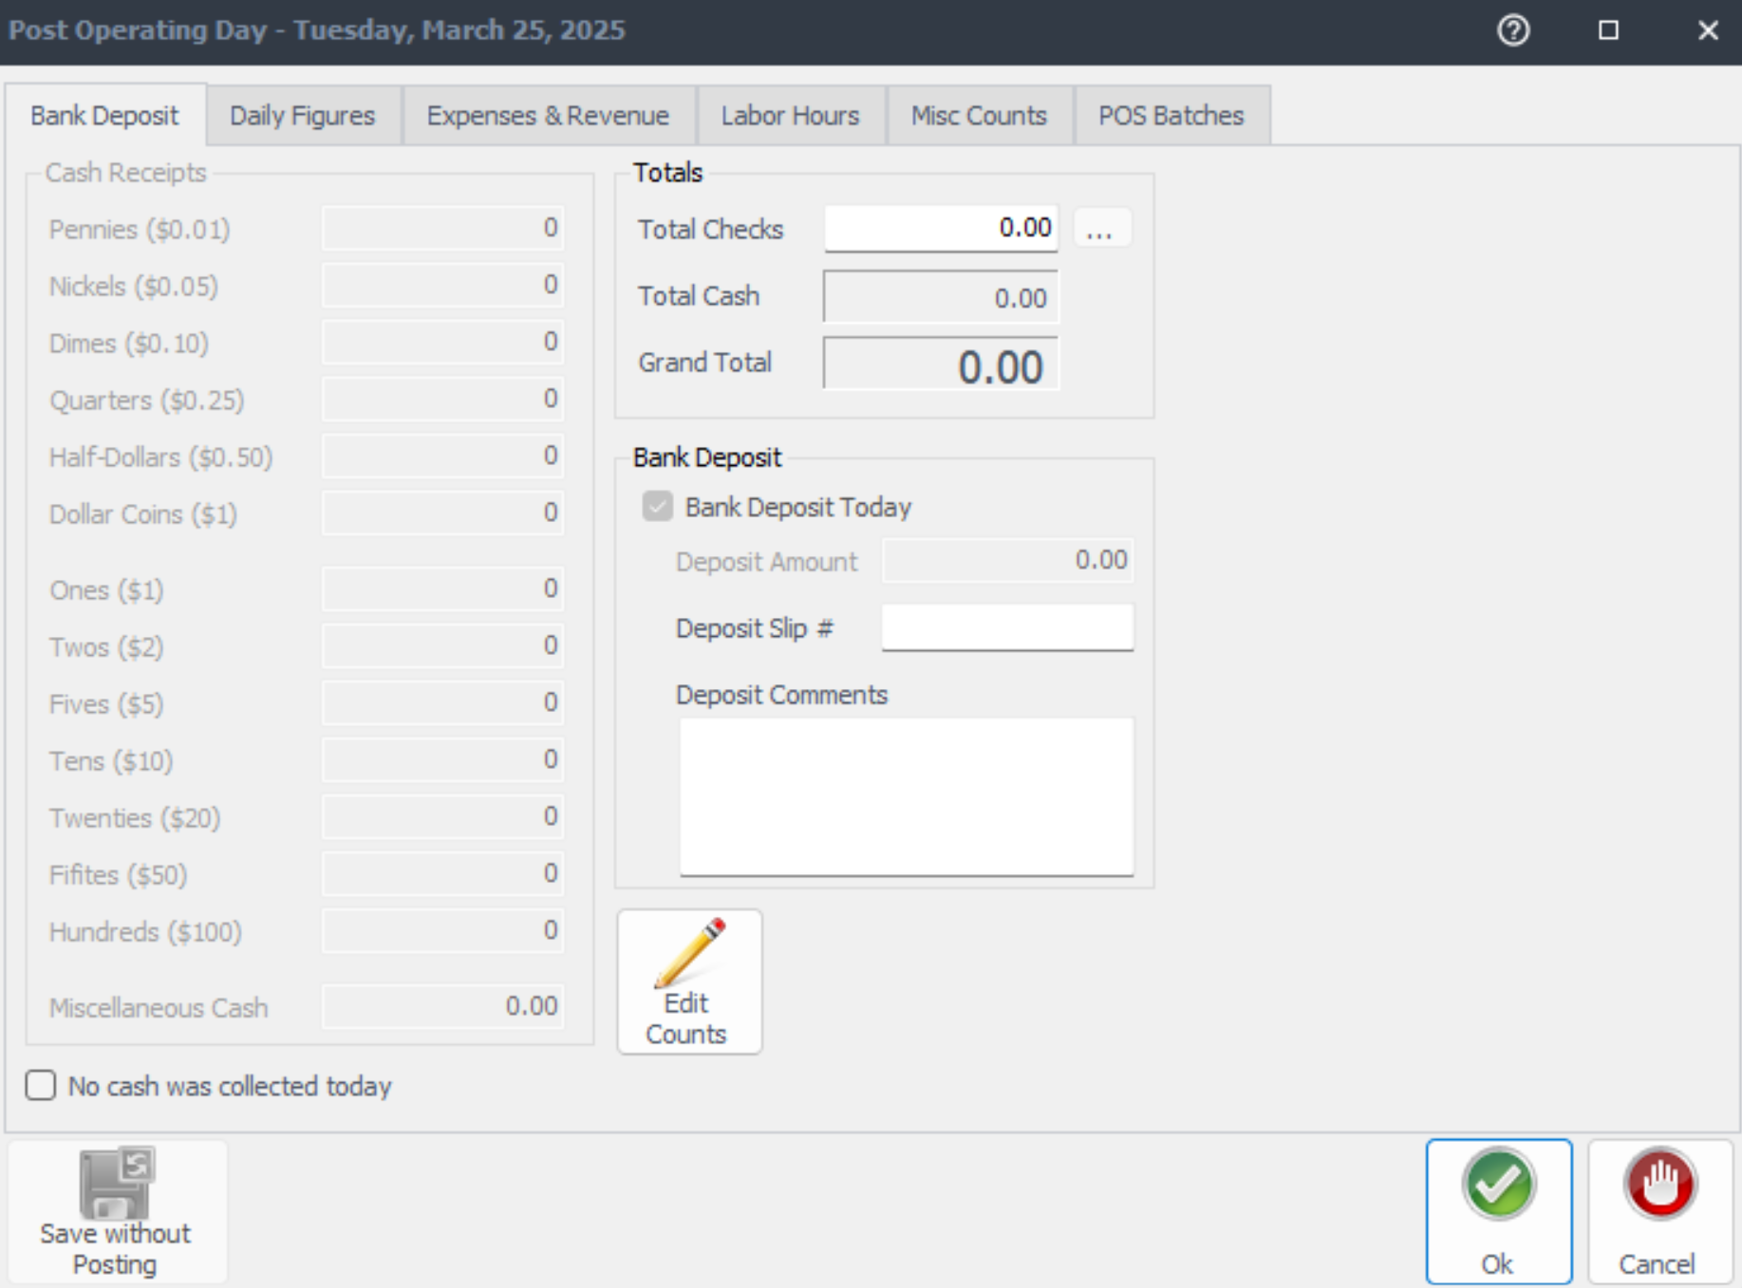

Same Day Supper Meal Count Input
When supper meal counts are entered the same day of service for reimbursement:
60
Click “Post Operating Day” in the daily checklist on the left hand side.
Enter supper meal counts on the “MISC Counts” tab.
Return to the “Bank Deposit” Tab. Click Reviewed then OK and your day has been posted.

Slide 42


Next Day Supper Meal Count Input
(7479) VERMONT on April 4, 2025
When supper meal counts are entered the next day of service for reimbursement:
Click “Enter After School Counts” on the left-hand side in the daily checklist.
4/7/2025
Select the date to be opened.
Enter Supper Meal Counts on the “Edit After School Counts” pop up then click OK.

Slide 43
After School Program Service
Meals are prepared by Food Services Staff; FS Staff then transports ASP supper meals to the ASP staff just before service
ASP Staff distributes meals to program students & assists with serving participants from the community for the first ten minutes of service.
Meals are consumed in the designated eating area. ASP staff assist with ensuring no food leaves the campus.
Meal service begins immediately after the dismissal bell rings, and lasts for 30 minutes.
ASP Supper Grid Sheet & Community Roster are required at the point of service.
ASP Staff ensures reimbursable meal is received before placing an "x" on the meal count form.
    *Exceptions may apply. AFSS approval is required to serve at alternate serving times.

Slide 44


Program Attendance Rosters
    Program attendance rosters record students present in afterschool programs and support the meal counts on the ASP Supper Grid sheet.
    Attendance Rosters must be:
      Greater than or equal to meal counts to support meal claims
      Include student names:
        Can be electronic or manual copies
        Must be submitted weekly
        If rosters are not submitted weekly contact your AFSS
Notes:
TELL: Program Attendance Rosters record students present in afterschool programs and support the meal counts on the ASP Supper Grid sheet. Attendance may be: taken before or after meal service, greater than or equal to meal counts. However, meal counts cannot exceed the attendance. These attendance rosters must be submitted to FSM weekly. As pictured, the correct attendance rosters are taken manually by hand.

Slide 45
Early Dismissal Policy
Example: Regular dismissal time is at 2:30pm.
    Meal service times are contingent upon school dismissal. Supper Meals are delivered to ASP staff no more than 15 mins before service unless specified otherwise.
Cut-Off Time: | Before 1:00 pm | After 1:00 pm
Rule: | Students are served at the regular dismissal time | Students are served at the early dismissal time
Scenario: | Students are dismissed at 12:50pm | Students are dismissed at 1:20pm
Service Time: | Students are served at *2:30pm | Students are served at 1:20pm
    *Exceptions may apply. AFSS approval is required to serve at alternate serving times.
Notes:
TELL: Meal service times are contingent upon school dismissal. Let’s Review the Early Dismissal Policy Chart. Early release days are now categorized into 2 simple categories.
CLICK
TELL: If the students are released before 1pm, Hot supper will be served at the regular dismissal time. For example. Let’s say the regular school dismissal is at 2:30pm.
CLICK
TELL: Let’s explore this scenario. Students are released at 12:50 pm.
CLICK
TELL: According to the Early Dismissal policy, Hot Supper will be served at 2:30 pm. Please note that *Exceptions may apply. AFSS approval is required to serve at alternate serving times.
CLICK
TELL: Let’s look at a different scenario. If the students are released earlier then their regular dismissal, but after 1pm. Then Hot supper will be served Immediately after the early dismissal time.
CLICK
TELL: Let’s explore this scenario. Students are released at 1:20 pm.
CLICK
TELL: According to the Early Dismissal policy, Hot Supper will be served at 1:20 pm.

Slide 46

Early Release Students
Service time may be adjusted to accommodate students released before the regular dismissal bell on a regular basis.
These students may include:
  Special Education Students
  Bussed Students
  Other Eligible Programs
Note: Include any changes to service times in the Supper Meal Program Online Form with AFSS approval
Example: The school’s dismissal is at 2:30pm, but Special Ed students are released at 2:15pm. Serving time is 2:15-3:00pm.
Notes:
TELL: Service time may be adjusted to accommodate students released before the regular dismissal bell on a regular basis.
These students include, Special Education students and bussed students, and other eligible programs. Note: Any change in the service time must be included in the Change of Supper Meal Service Form. For example: The school’s dismissal is at 2:30pm, but Special Ed students are released at 2:15pm. Serving time is 2:15-3:00pm.

Slide 47

Review the spreadsheet for accuracy
Supper Program Online Form
The supper program online form must be completed at the beginning of each school year
Update the online form as changes occur. This includes:
  Serving times
  Additional after school programs
  Additional designated eating locations
  And other changes that may occur
Notes:
TELL: Enter service time(s), date(s), and designated eating area(s) on the Permanent Supper Meal Online Form. If you have a Saturday program, use the new Saturday Supper online form. Remember to update the Temporary/Short Term Supper Program Online Form for changes that are 6 days or less. Lastly, review the spreadsheet for accuracy.

Slide 48
Defining Key Roles and Responsibilities

Slide 49
Food Services Manager Role
Order Food
Staff the Program
Collect & Verify Documents
FOH Daily Entry
File Records
Monitor Program
Notes:
TELL: The review the role of the Food Services Manager. FSMs will order food items based on the hot supper menu.
CLICK
TELL: They will ensure that their program is staffed accordingly.
CLICK
TELL: Collect & verify all documents for accuracy.
CLICK
TELL: Enter daily meal counts in CMS Daily Entry.
CLICK
TELL: Maintain & file all records.
CLICK
TELL: Monitor program (3 per year) & provide corrective action.

Slide 50
Food Services
Staff Role
Pre-Service
Prepare & pack supper meals according to the menu for all service areas
Notes:
TELL: Before supper service begins, Food Services staff will prepare & pack the hot supper meals according to the menu for all service areas.

Slide 51
Delivers supper meals to ASP staff to distribute to ASP participants
Distribute supper meals to community participants
Food Services
Staff Role
Ensure reimbursable meals are marked on the community roster
During Service
Direct all participants to the designated eating area
Ensure no food leaves the campus

Slide 52
Count & record all leftovers
Check the temperatures of leftovers. Cold items may be returned to stock. Discard all hot items
Food Services
Staff Role
Post Service
Clean & sanitize insulated bags & carts

Slide 53
Distribute meals to program students and assist community for the first 10 minutes or as needed
Supervise & direct students to the designated eating area
ASP Staff
Make sure program is open to the community
Clean spills, wipe tables, pick up trash & empty bins
Responsibilities
Total daily attendance for all programs and record accurate meal counts
Ensure no food is taken from campus

Slide 54
ASP Staff
WILL NOT
Prepare any food items
Push community carts out to designated areas
Remove hot food from warmers or ovens
Serve participants inside the kitchen area

Slide 55
Monitoring
Dates
    In compliance with CDSS requirements, supper monitoring’s must be completed no more than six months apart from one another:
      1st, 2nd and 3rd unannounced monitoring’s must be completed by the following dates:
      1st – 9/26/25
      2nd – 2/13/26
      3rd – 5/9/26
Notes:
TELL: The Supper Monitoring Scheduler is a tool to ensure monitoring dates are varied per CDE standards. AFSS provides FSM with scheduled monitoring dates. Then, FSM records dates on scheduler as a reminder to complete monitorings.

Slide 56



Afterschool Early Childhood Programs
The Afterschool Early Childhood Program will now be receiving supper in place of snack:
  FSM will pack the insulated BIC bag with menu items suitable for 4 and under students.
  AECP staff will pick up bags, plus Daily Transport Record and Community Roster for service.
  Please review the AECP training under Supper on the Food Service website for more information

Slide 57
Handling
Challenges
Student attempts to walk out of campus with the supper meal.
Redirect students to eat in the designated eating area.
Parent is rude or is upset after being reminded of rules.
Inform administration of the incident and request assistance.
Despite your efforts, supper regulations are not being followed.
Inform AFSS that
your repeated efforts are unsuccessful.
Notes:
TELL: Here is a guide on handling challenges. Student attempts to walk out of campus with the supper meal.
CLICK
TELL: Redirect students to eat their meal in the designated eating area. Parent is rude or is upset after being reminded of rules.
CLICK
TELL: Inform administration of the incident and request assistance. Despite your efforts, supper regulations are not being followed.
CLICK
TELL: Inform AFSS that your repeated efforts are unsuccessful.

Slide 58

Good Nutrition
All Day Long
    Providing healthy meals shouldn’t stop once the last bell rings. Often times, parents are still at work when their children get out of school.
    Serving hot supper meals allows children to receive three nutritious meals a day to support their growing bodies and learning needs.
Notes:
TELL: Providing healthy meals shouldn’t stop once the last bell rings. Often times, parents are still at work when their children get out of school. Serving hot supper meals allows the children to receive three nutritious meals a day to support their growing bodies and learning needs. Doing this will ensure that together, we are continuing to provide good nutrition all day long.

